Slide 1
Database
Shwetha.K.R

Slide 2
Oracle & RDBMS
Oracle Architecture and its features
Normalization
DDL
DML
DCL
Constraints
Relationships

Slide 3
Database with Oracle

Slide 4
Exploring the Oracle DB Architecture
DB Basics
Memory Structure
Process Structure
Storage Structure

Slide 5
DB Basics
Database: shared, integrated computer structure that stores a collection of:
End-user data: raw facts of interest to end user
Metadata: data about data
Provides description of data characteristics and relationships in data
Complements and expands value of data
Database management system (DBMS): collection of programs
Manages structure and controls access to data
Notes:
In an embedded system,
the processor would generally be a special purpose chip tailored for a specific application (e.g. cell phone processor, digital camera processor etc.)
BUS technology can be popular ones like PCI, PCIE, ISA etc.
There can be multiple levels of cache like L1, L2, L3 etc. for speeding up the instruction and data retrieval process
The size of the primary and secondary memories would vary based on the requirements of the system (e.g. a cell phone DRAM may be much lesser than that of a PC)
A variety of input and output devices based on the device like keypad, touchpad, LCD etc.
Communication Interfaces like Ethernet, Serial, Parallel etc. for the device to communicate with the external world
Special Purpose DSPs (Digital Signal Processors) for doing specific compute intensive mathematical operations (e.g. Analog to Digital Conversions).

Slide 6
Memory Structure
Oracle Instance: Memory Structure, RAC
System Global Area(SGA)
DB Buffer: Scratch space for SQL
Log Buffer : Staging area for redo log
Shared Pool : Result Cache
Programming Global Area(PGA) : 1 per user session

Slide 7
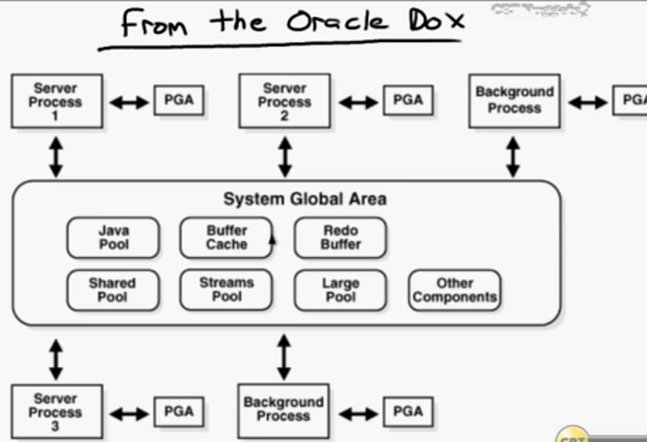
From the Oracle Dox

Slide 8
Sizing the memory Structure
Automatic Memory Management
Manually Shared Memory Management
Config Methods
DBCA
SQL* plus Console
EM Console

Slide 9
Background Process
Start instance startup, stop instance shutdown
Linux: Each Process individually
Windows: Oracle.exe
Oracle process run as threads
Select program from v$process order by program;

Slide 10
Major Process
SMON: Mounts opens DB, Collates free space
PMON: Monitor users processes and detects problems
DBWn : Writes memory buffers to disk
LGWR : Writes log buffers to redo log files on disk
CKPT : incrementally instructs DBWn to write out dirty buffers to data files

Slide 11
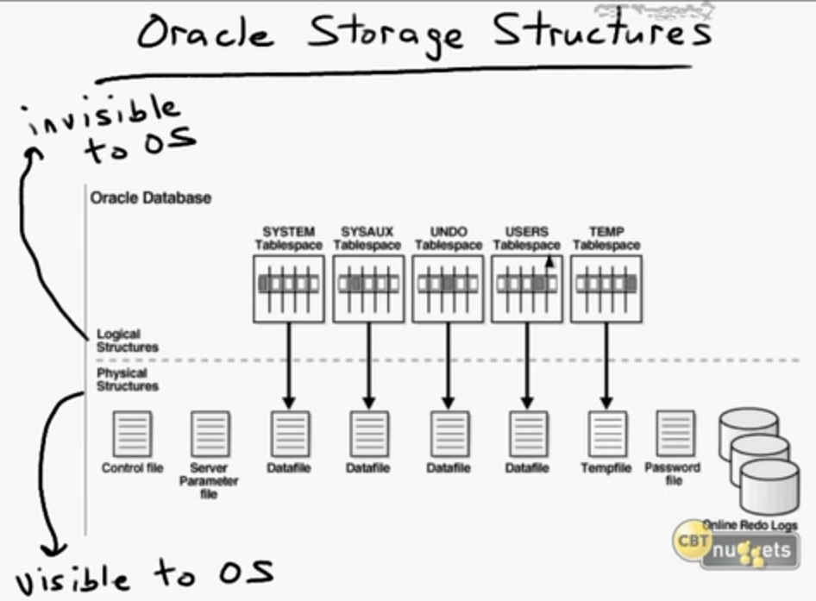
Storage Structure

Slide 12
Physical structure
Control file : Contains pointers to parts of db –data files, redo logs, meta data.
Online Redo log files : Store every query applied to db
Data Files: data blocks

Slide 13
Logical Structure
Oracle Blocks: fundamental data unit in oracle DB
8 KB, create tablespace t01 blocksize 8k;
Extents : Collection of blocks, defined 1 MB
Locally managed tablespaces
Segments : collection of extents stored in the same tablespace
Allocated to objects
Tablespaces : log storage of DB
Schemas, objects

Slide 14
Data Dictionary
Read only collection: tables, views
View prefixes :
USER : metadata for users stuff
ALL : Accessible to current user
DBA : for every object

Slide 15
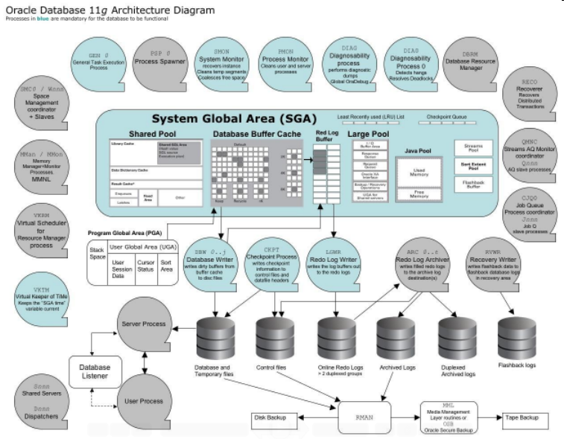
Oracle Architecture

Slide 16
Types of Databases
Hierarchical database
Network database
Relational database
Object-oriented database

Slide 17
HIERARCHICAL DATABASE
A DBMS is said to be hierarchical if the relationships among data in the database are established in such a way that one data item is present as the subordinate of another one.
Here subordinate means that items have 'parent-child' relationships among them. Direct relationships exist between any two records that are stored consecutively. The data structure "tree" is followed by the DBMS to structure the database. No backward movement is possible/allowed in the hierarchical database.

Slide 18
NETWORK DATABASE
A DBMS is said to be a Network DBMS if the relationships among data in the database are of type many-to-many.
The relationships among many-to-many appears in the form of a network. Thus the structure of a network database is extremely complicated because of these many-to-many relationships in which one record can be used as a key of the entire database. A network database is structured in the form of a graph that is also a data structure.

Slide 19
RELATIONAL DATABASE
A DBMS is said to be a Relational DBMS or RDBMS if the database relationships are treated in the form of a table. there are three keys on relational DBMS 1)relation 2)domain 3)attributes.
A network means it contains fundamentel constructs sets or records.sets contains one to many relationship,records contains fields statical table that is composed of rows and columns is used to organize the database and its structure and is actually a two dimension array in the computer memory. A number of RDBMSs are available, some popular examples are Oracle, Sybase, Ingress,Informix, Microsoft SQL Server, and Microsoft Access.

Slide 20
OBJECT-ORIENTED DATABASE
Object-oriented databases use small, reusable chunks of software called objects. The objects themselves are stored in the object-oriented database. Each object consists of two elements: 1) a piece of data (e.g., sound, video, text, or graphics), and 2) the instructions, or software programs called methods, for what to do with the data.
Object-oriented databases have two disadvantages. First, they are more costly to develop. Second, most organizations are reluctant to abandon or convert from those databases that they have already invested money in developing and implementing. However, the benefits to object-oriented databases are compelling. The ability to mix and match reusable objects provides incredible multimedia capability.

Slide 21
Introduction
Database Concepts
Good decisions require good information derived from raw facts
Data is managed most efficiently when stored in a database
Databases evolved from computer file systems
Understanding file system characteristics is important
Notes:
The hardware inside a PC typically consists of
A main processor or CPU used for computational purposes
A Boot ROM for holding the initial boot software
A primary memory in the form of a DRAM for temporarily holding instructions and data
A secondary memory in the form of a hard disk and a disk controller for controlling the hard disk
Input units in the form of keyboard and mouse along with their respective controllers
Output units in the form of monitor along with its controller to display the results
One or more Network Interface Cards for enabling the PC to interface with other machines
One or more BUS lines for interconnecting the above hardware. Each BUS consists of address, data and control lines.
The software of a PC mainly consist of
An OS to interface between the hardware and the application programs
The variety of application programs that end users typically use like Browser, Calculator, MS-Office etc.

Slide 22
Why Databases
Database Concepts
Databases solve many of the problems encountered in data management
Used in almost all modern settings involving data management:
Business
Research
Administration
Important to understand how databases work and interact with other applications
Notes:
The above diagram typically illustrates the functional units of a computer or an embedded system
It consists of the Processor, Memory and I/O units.
The I/O units transfer data to and from the memory and they generally do not directly interact with the Processor, excepting for interrupting them.
The Processor takes instructions and data from the memory, executes it and stores back the results in the memory.

Slide 23
Data vs Information
Database Concepts
Data are raw facts
Information is the result of processing raw data to reveal meaning
Information requires context to reveal meaning
Raw data must be formatted for storage, processing, and presentation
Data are the foundation of information, which is the bedrock of knowledge

Slide 24
Data vs Information
Database Concepts
Data: building blocks of information
Information produced by processing data
Information used to reveal meaning in data
Accurate, relevant, timely information is the key to good decision making
Good decision making is the key to organizational survival

Slide 25
Introducing the Database
Database Concepts
Database: shared, integrated computer structure that stores a collection of:
End-user data: raw facts of interest to end user
Metadata: data about data
Provides description of data characteristics and relationships in data
Complements and expands value of data
Database management system (DBMS): collection of programs
Manages structure and controls access to data
Notes:
In an embedded system,
the processor would generally be a special purpose chip tailored for a specific application (e.g. cell phone processor, digital camera processor etc.)
BUS technology can be popular ones like PCI, PCIE, ISA etc.
There can be multiple levels of cache like L1, L2, L3 etc. for speeding up the instruction and data retrieval process
The size of the primary and secondary memories would vary based on the requirements of the system (e.g. a cell phone DRAM may be much lesser than that of a PC)
A variety of input and output devices based on the device like keypad, touchpad, LCD etc.
Communication Interfaces like Ethernet, Serial, Parallel etc. for the device to communicate with the external world
Special Purpose DSPs (Digital Signal Processors) for doing specific compute intensive mathematical operations (e.g. Analog to Digital Conversions).

Slide 26
Role and Advantages of the DBMS
Database Concepts
DBMS is the intermediary between the user and the database
Database structure stored as file collection
Can only access files through the DBMS
DBMS enables data to be shared
DBMS integrates many users’ views of the data
Notes:
SOCs (System On Chips) are powerful processors with lot of additional hardware required for an embedded system included inside it.
For e.g. an SOC may have a Core CPU, some internal ROM, RAM, Cache, standard I/O circuits, A/D DSPs, Timer Circuits all build inside a single chip.

Slide 27
Role and Advantages of DBMS
Database Concepts
Advantages of a DBMS:
Improved data sharing
Improved data security
Better data integration
Minimized data inconsistency
Improved data access
Improved decision making
Increased end-user productivity

Slide 28
Types of Databases
Database Concepts
Databases can be classified according to:
Number of users
Database location(s)
Expected type and extent of use
Single-user database supports only one user at a time
Desktop database: single-user; runs on PC
Multiuser database supports multiple users at the same time
Workgroup and enterprise databases

Slide 29
Types of Databases
Database Concepts
Centralized Database: data located at a single site
Distributed Database: data distributed across several different sites
Operational Database: supports a company’s day-to-day operations
Transactional or production database
Data Warehouse: stores data used for tactical or strategic decisions
Notes:
In an embedded system,
the processor would generally be a special purpose chip tailored for a specific application (e.g. cell phone processor, digital camera processor etc.)
BUS technology can be popular ones like PCI, PCIE, ISA etc.
There can be multiple levels of cache like L1, L2, L3 etc. for speeding up the instruction and data retrieval process
The size of the primary and secondary memories would vary based on the requirements of the system (e.g. a cell phone DRAM may be much lesser than that of a PC)
A variety of input and output devices based on the device like keypad, touchpad, LCD etc.
Communication Interfaces like Ethernet, Serial, Parallel etc. for the device to communicate with the external world
Special Purpose DSPs (Digital Signal Processors) for doing specific compute intensive mathematical operations (e.g. Analog to Digital Conversions).

Slide 30
Types of Databases
Database Concepts
Unstructured data exist in their original state
Structured data result from formatting
Structure applied based on type of processing to be performed
Semi structured data have been processed to some extent
Extensible Markup Language (XML) represents data elements in textual format
XML database supports semi structured XML data
Notes:
In an embedded system,
the processor would generally be a special purpose chip tailored for a specific application (e.g. cell phone processor, digital camera processor etc.)
BUS technology can be popular ones like PCI, PCIE, ISA etc.
There can be multiple levels of cache like L1, L2, L3 etc. for speeding up the instruction and data retrieval process
The size of the primary and secondary memories would vary based on the requirements of the system (e.g. a cell phone DRAM may be much lesser than that of a PC)
A variety of input and output devices based on the device like keypad, touchpad, LCD etc.
Communication Interfaces like Ethernet, Serial, Parallel etc. for the device to communicate with the external world
Special Purpose DSPs (Digital Signal Processors) for doing specific compute intensive mathematical operations (e.g. Analog to Digital Conversions).

Slide 31
Database Design
Database Concepts
Database design focuses on design of database structure used for end-user data
Designer must identify database’s expected use
Well-designed database:
Facilitates data management
Generates accurate and valuable information
Poorly designed database:
Causes difficult-to-trace errors
Notes:
In an embedded system,
the processor would generally be a special purpose chip tailored for a specific application (e.g. cell phone processor, digital camera processor etc.)
BUS technology can be popular ones like PCI, PCIE, ISA etc.
There can be multiple levels of cache like L1, L2, L3 etc. for speeding up the instruction and data retrieval process
The size of the primary and secondary memories would vary based on the requirements of the system (e.g. a cell phone DRAM may be much lesser than that of a PC)
A variety of input and output devices based on the device like keypad, touchpad, LCD etc.
Communication Interfaces like Ethernet, Serial, Parallel etc. for the device to communicate with the external world
Special Purpose DSPs (Digital Signal Processors) for doing specific compute intensive mathematical operations (e.g. Analog to Digital Conversions).

Slide 32
Structural and Data dependence
Database Concepts
Structural dependence: access to a file is dependent on its own structure
All file system programs must be modified to conform to a new file structure
Structural independence: change file structure without affecting data access
Data dependence: data access changes when data storage characteristics change
Data independence: data storage characteristics do not affect data access
Notes:
In an embedded system,
the processor would generally be a special purpose chip tailored for a specific application (e.g. cell phone processor, digital camera processor etc.)
BUS technology can be popular ones like PCI, PCIE, ISA etc.
There can be multiple levels of cache like L1, L2, L3 etc. for speeding up the instruction and data retrieval process
The size of the primary and secondary memories would vary based on the requirements of the system (e.g. a cell phone DRAM may be much lesser than that of a PC)
A variety of input and output devices based on the device like keypad, touchpad, LCD etc.
Communication Interfaces like Ethernet, Serial, Parallel etc. for the device to communicate with the external world
Special Purpose DSPs (Digital Signal Processors) for doing specific compute intensive mathematical operations (e.g. Analog to Digital Conversions).

Slide 33
Structural and Data dependence
Database Concepts
Practical significance of data dependence is difference between logical and physical format
Logical data format: how human views the data
Physical data format: how computer must work with data
Each program must contain:
Lines specifying opening of specific file type
Record specification
Field definitions
Notes:
In an embedded system,
the processor would generally be a special purpose chip tailored for a specific application (e.g. cell phone processor, digital camera processor etc.)
BUS technology can be popular ones like PCI, PCIE, ISA etc.
There can be multiple levels of cache like L1, L2, L3 etc. for speeding up the instruction and data retrieval process
The size of the primary and secondary memories would vary based on the requirements of the system (e.g. a cell phone DRAM may be much lesser than that of a PC)
A variety of input and output devices based on the device like keypad, touchpad, LCD etc.
Communication Interfaces like Ethernet, Serial, Parallel etc. for the device to communicate with the external world
Special Purpose DSPs (Digital Signal Processors) for doing specific compute intensive mathematical operations (e.g. Analog to Digital Conversions).

Slide 34
Data Redundancy
Database Concepts
File system structure makes it difficult to combine data from multiple sources
Vulnerable to security breaches
Organizational structure promotes storage of same data in different locations
Islands of information
Data stored in different locations is unlikely to be updated consistently
Data redundancy: same data stored unnecessarily in different places
Notes:
In an embedded system,
the processor would generally be a special purpose chip tailored for a specific application (e.g. cell phone processor, digital camera processor etc.)
BUS technology can be popular ones like PCI, PCIE, ISA etc.
There can be multiple levels of cache like L1, L2, L3 etc. for speeding up the instruction and data retrieval process
The size of the primary and secondary memories would vary based on the requirements of the system (e.g. a cell phone DRAM may be much lesser than that of a PC)
A variety of input and output devices based on the device like keypad, touchpad, LCD etc.
Communication Interfaces like Ethernet, Serial, Parallel etc. for the device to communicate with the external world
Special Purpose DSPs (Digital Signal Processors) for doing specific compute intensive mathematical operations (e.g. Analog to Digital Conversions).

Slide 35
Data Redundancy
Database Concepts
Data inconsistency: different and conflicting versions of same data occur at different places
Data anomalies: abnormalities when all changes in redundant data are not made correctly
Update anomalies
Insertion anomalies
Deletion anomalies
Notes:
In an embedded system,
the processor would generally be a special purpose chip tailored for a specific application (e.g. cell phone processor, digital camera processor etc.)
BUS technology can be popular ones like PCI, PCIE, ISA etc.
There can be multiple levels of cache like L1, L2, L3 etc. for speeding up the instruction and data retrieval process
The size of the primary and secondary memories would vary based on the requirements of the system (e.g. a cell phone DRAM may be much lesser than that of a PC)
A variety of input and output devices based on the device like keypad, touchpad, LCD etc.
Communication Interfaces like Ethernet, Serial, Parallel etc. for the device to communicate with the external world
Special Purpose DSPs (Digital Signal Processors) for doing specific compute intensive mathematical operations (e.g. Analog to Digital Conversions).

Slide 36
Design and Data Modeling
Database Concepts
Most users lack the skill to properly design databases, despite multiple personal productivity tools being available
Data-modeling skills are vital in the data design process
Good data modeling facilitates communication between the designer, user, and the developer
Notes:
In an embedded system,
the processor would generally be a special purpose chip tailored for a specific application (e.g. cell phone processor, digital camera processor etc.)
BUS technology can be popular ones like PCI, PCIE, ISA etc.
There can be multiple levels of cache like L1, L2, L3 etc. for speeding up the instruction and data retrieval process
The size of the primary and secondary memories would vary based on the requirements of the system (e.g. a cell phone DRAM may be much lesser than that of a PC)
A variety of input and output devices based on the device like keypad, touchpad, LCD etc.
Communication Interfaces like Ethernet, Serial, Parallel etc. for the device to communicate with the external world
Special Purpose DSPs (Digital Signal Processors) for doing specific compute intensive mathematical operations (e.g. Analog to Digital Conversions).

Slide 37
Database Systems
Database Concepts
Database system consists of logically related data stored in a single logical data repository
May be physically distributed among multiple storage facilities
DBMS eliminates most of file system’s problems
Current generation stores data structures, relationships between structures, and access paths
Also defines, stores, and manages all access paths and components
Notes:
In an embedded system,
the processor would generally be a special purpose chip tailored for a specific application (e.g. cell phone processor, digital camera processor etc.)
BUS technology can be popular ones like PCI, PCIE, ISA etc.
There can be multiple levels of cache like L1, L2, L3 etc. for speeding up the instruction and data retrieval process
The size of the primary and secondary memories would vary based on the requirements of the system (e.g. a cell phone DRAM may be much lesser than that of a PC)
A variety of input and output devices based on the device like keypad, touchpad, LCD etc.
Communication Interfaces like Ethernet, Serial, Parallel etc. for the device to communicate with the external world
Special Purpose DSPs (Digital Signal Processors) for doing specific compute intensive mathematical operations (e.g. Analog to Digital Conversions).

Slide 38
Database System Environment
Database Concepts
Database system: defines and regulates the collection, storage, management, use of data
Five major parts of a database system:
Hardware
Software
People
Procedures
Data
Notes:
In an embedded system,
the processor would generally be a special purpose chip tailored for a specific application (e.g. cell phone processor, digital camera processor etc.)
BUS technology can be popular ones like PCI, PCIE, ISA etc.
There can be multiple levels of cache like L1, L2, L3 etc. for speeding up the instruction and data retrieval process
The size of the primary and secondary memories would vary based on the requirements of the system (e.g. a cell phone DRAM may be much lesser than that of a PC)
A variety of input and output devices based on the device like keypad, touchpad, LCD etc.
Communication Interfaces like Ethernet, Serial, Parallel etc. for the device to communicate with the external world
Special Purpose DSPs (Digital Signal Processors) for doing specific compute intensive mathematical operations (e.g. Analog to Digital Conversions).

Slide 39
Database System Environment
Database Concepts
Hardware: all the system’s physical devices
Software: three types of software required:
Operating system software
DBMS software
Application programs and utility software
Notes:
In an embedded system,
the processor would generally be a special purpose chip tailored for a specific application (e.g. cell phone processor, digital camera processor etc.)
BUS technology can be popular ones like PCI, PCIE, ISA etc.
There can be multiple levels of cache like L1, L2, L3 etc. for speeding up the instruction and data retrieval process
The size of the primary and secondary memories would vary based on the requirements of the system (e.g. a cell phone DRAM may be much lesser than that of a PC)
A variety of input and output devices based on the device like keypad, touchpad, LCD etc.
Communication Interfaces like Ethernet, Serial, Parallel etc. for the device to communicate with the external world
Special Purpose DSPs (Digital Signal Processors) for doing specific compute intensive mathematical operations (e.g. Analog to Digital Conversions).

Slide 40
Database System Environment
Database Concepts
People: all users of the database system
System and database administrators
Database designers
Systems analysts and programmers
End users
Procedures: instructions and rules that govern the design and use of the database system
Data: the collection of facts stored in the database
Notes:
In an embedded system,
the processor would generally be a special purpose chip tailored for a specific application (e.g. cell phone processor, digital camera processor etc.)
BUS technology can be popular ones like PCI, PCIE, ISA etc.
There can be multiple levels of cache like L1, L2, L3 etc. for speeding up the instruction and data retrieval process
The size of the primary and secondary memories would vary based on the requirements of the system (e.g. a cell phone DRAM may be much lesser than that of a PC)
A variety of input and output devices based on the device like keypad, touchpad, LCD etc.
Communication Interfaces like Ethernet, Serial, Parallel etc. for the device to communicate with the external world
Special Purpose DSPs (Digital Signal Processors) for doing specific compute intensive mathematical operations (e.g. Analog to Digital Conversions).

Slide 41
Database System Environment
Database Concepts
Database systems are created and managed at different levels of complexity
Database solutions must be cost-effective as well as tactically and strategically effective
Database technology already in use affects selection of a database system
Notes:
In an embedded system,
the processor would generally be a special purpose chip tailored for a specific application (e.g. cell phone processor, digital camera processor etc.)
BUS technology can be popular ones like PCI, PCIE, ISA etc.
There can be multiple levels of cache like L1, L2, L3 etc. for speeding up the instruction and data retrieval process
The size of the primary and secondary memories would vary based on the requirements of the system (e.g. a cell phone DRAM may be much lesser than that of a PC)
A variety of input and output devices based on the device like keypad, touchpad, LCD etc.
Communication Interfaces like Ethernet, Serial, Parallel etc. for the device to communicate with the external world
Special Purpose DSPs (Digital Signal Processors) for doing specific compute intensive mathematical operations (e.g. Analog to Digital Conversions).

Slide 42
DBMS Functions
Database Concepts
Most functions are transparent to end users
Can only be achieved through the DBMS
Data dictionary management
DBMS stores definitions of data elements and relationships (metadata) in a data dictionary
DBMS looks up required data component structures and relationships
Changes automatically recorded in the dictionary
DBMS provides data abstraction and removes structural and data dependency
Notes:
In an embedded system,
the processor would generally be a special purpose chip tailored for a specific application (e.g. cell phone processor, digital camera processor etc.)
BUS technology can be popular ones like PCI, PCIE, ISA etc.
There can be multiple levels of cache like L1, L2, L3 etc. for speeding up the instruction and data retrieval process
The size of the primary and secondary memories would vary based on the requirements of the system (e.g. a cell phone DRAM may be much lesser than that of a PC)
A variety of input and output devices based on the device like keypad, touchpad, LCD etc.
Communication Interfaces like Ethernet, Serial, Parallel etc. for the device to communicate with the external world
Special Purpose DSPs (Digital Signal Processors) for doing specific compute intensive mathematical operations (e.g. Analog to Digital Conversions).

Slide 43
DBMS Functions
Database Concepts
Data storage management
DBMS creates and manages complex structures required for data storage
Also stores related data entry forms, screen definitions, report definitions, etc.
Performance tuning: activities that make the database perform more efficiently
DBMS stores the database in multiple physical data files
Notes:
In an embedded system,
the processor would generally be a special purpose chip tailored for a specific application (e.g. cell phone processor, digital camera processor etc.)
BUS technology can be popular ones like PCI, PCIE, ISA etc.
There can be multiple levels of cache like L1, L2, L3 etc. for speeding up the instruction and data retrieval process
The size of the primary and secondary memories would vary based on the requirements of the system (e.g. a cell phone DRAM may be much lesser than that of a PC)
A variety of input and output devices based on the device like keypad, touchpad, LCD etc.
Communication Interfaces like Ethernet, Serial, Parallel etc. for the device to communicate with the external world
Special Purpose DSPs (Digital Signal Processors) for doing specific compute intensive mathematical operations (e.g. Analog to Digital Conversions).

Slide 44
DBMS Functions
Database Concepts
Data transformation and presentation
DBMS transforms data entered to conform to required data structures
DBMS transforms physically retrieved data to conform to user’s logical expectations
Security management
DBMS creates a security system that enforces user security and data privacy
Security rules determine which users can access the database, which items can be accessed, etc.
Notes:
In an embedded system,
the processor would generally be a special purpose chip tailored for a specific application (e.g. cell phone processor, digital camera processor etc.)
BUS technology can be popular ones like PCI, PCIE, ISA etc.
There can be multiple levels of cache like L1, L2, L3 etc. for speeding up the instruction and data retrieval process
The size of the primary and secondary memories would vary based on the requirements of the system (e.g. a cell phone DRAM may be much lesser than that of a PC)
A variety of input and output devices based on the device like keypad, touchpad, LCD etc.
Communication Interfaces like Ethernet, Serial, Parallel etc. for the device to communicate with the external world
Special Purpose DSPs (Digital Signal Processors) for doing specific compute intensive mathematical operations (e.g. Analog to Digital Conversions).

Slide 45
DBMS Functions
Database Concepts
Multiuser access control
DBMS uses sophisticated algorithms to ensure concurrent access does not affect integrity
Backup and recovery management
DBMS provides backup and data recovery to ensure data safety and integrity
Recovery management deals with recovery of database after a failure
Critical to preserving database’s integrity
Notes:
In an embedded system,
the processor would generally be a special purpose chip tailored for a specific application (e.g. cell phone processor, digital camera processor etc.)
BUS technology can be popular ones like PCI, PCIE, ISA etc.
There can be multiple levels of cache like L1, L2, L3 etc. for speeding up the instruction and data retrieval process
The size of the primary and secondary memories would vary based on the requirements of the system (e.g. a cell phone DRAM may be much lesser than that of a PC)
A variety of input and output devices based on the device like keypad, touchpad, LCD etc.
Communication Interfaces like Ethernet, Serial, Parallel etc. for the device to communicate with the external world
Special Purpose DSPs (Digital Signal Processors) for doing specific compute intensive mathematical operations (e.g. Analog to Digital Conversions).

Slide 46
DBMS Functions
Database Concepts
Data integrity management
DBMS promotes and enforces integrity rules
Minimizes redundancy
Maximizes consistency
Data relationships stored in data dictionary used to enforce data integrity
Integrity is especially important in transaction-oriented database systems
Notes:
In an embedded system,
the processor would generally be a special purpose chip tailored for a specific application (e.g. cell phone processor, digital camera processor etc.)
BUS technology can be popular ones like PCI, PCIE, ISA etc.
There can be multiple levels of cache like L1, L2, L3 etc. for speeding up the instruction and data retrieval process
The size of the primary and secondary memories would vary based on the requirements of the system (e.g. a cell phone DRAM may be much lesser than that of a PC)
A variety of input and output devices based on the device like keypad, touchpad, LCD etc.
Communication Interfaces like Ethernet, Serial, Parallel etc. for the device to communicate with the external world
Special Purpose DSPs (Digital Signal Processors) for doing specific compute intensive mathematical operations (e.g. Analog to Digital Conversions).

Slide 47
DBMS Functions
Database Concepts
Database access languages and application programming interfaces
DBMS provides access through a query language
Query language is a nonprocedural language
Structured Query Language (SQL) is the de facto query language
Standard supported by majority of DBMS vendors
Notes:
In an embedded system,
the processor would generally be a special purpose chip tailored for a specific application (e.g. cell phone processor, digital camera processor etc.)
BUS technology can be popular ones like PCI, PCIE, ISA etc.
There can be multiple levels of cache like L1, L2, L3 etc. for speeding up the instruction and data retrieval process
The size of the primary and secondary memories would vary based on the requirements of the system (e.g. a cell phone DRAM may be much lesser than that of a PC)
A variety of input and output devices based on the device like keypad, touchpad, LCD etc.
Communication Interfaces like Ethernet, Serial, Parallel etc. for the device to communicate with the external world
Special Purpose DSPs (Digital Signal Processors) for doing specific compute intensive mathematical operations (e.g. Analog to Digital Conversions).

Slide 48
DBMS Functions
Database Concepts
Database Communication Interfaces
Current DBMSs accept end-user requests via multiple different network environments
Communications accomplished in several ways:
End users generate answers to queries by filling in screen forms through Web browser
DBMS automatically publishes predefined reports on a Web site
DBMS connects to third-party systems to distribute information via e-mail
Notes:
In an embedded system,
the processor would generally be a special purpose chip tailored for a specific application (e.g. cell phone processor, digital camera processor etc.)
BUS technology can be popular ones like PCI, PCIE, ISA etc.
There can be multiple levels of cache like L1, L2, L3 etc. for speeding up the instruction and data retrieval process
The size of the primary and secondary memories would vary based on the requirements of the system (e.g. a cell phone DRAM may be much lesser than that of a PC)
A variety of input and output devices based on the device like keypad, touchpad, LCD etc.
Communication Interfaces like Ethernet, Serial, Parallel etc. for the device to communicate with the external world
Special Purpose DSPs (Digital Signal Processors) for doing specific compute intensive mathematical operations (e.g. Analog to Digital Conversions).

Slide 49
Manage the Database
Database Concepts
Database system provides a framework in which strict procedures and standards enforced
Role of human changes from programming to managing organization’s resources
Database system enables more sophisticated use of the data
Data structures created within the database and their relationships determine effectiveness
Notes:
In an embedded system,
the processor would generally be a special purpose chip tailored for a specific application (e.g. cell phone processor, digital camera processor etc.)
BUS technology can be popular ones like PCI, PCIE, ISA etc.
There can be multiple levels of cache like L1, L2, L3 etc. for speeding up the instruction and data retrieval process
The size of the primary and secondary memories would vary based on the requirements of the system (e.g. a cell phone DRAM may be much lesser than that of a PC)
A variety of input and output devices based on the device like keypad, touchpad, LCD etc.
Communication Interfaces like Ethernet, Serial, Parallel etc. for the device to communicate with the external world
Special Purpose DSPs (Digital Signal Processors) for doing specific compute intensive mathematical operations (e.g. Analog to Digital Conversions).

Slide 50
Manage the Database
Database Concepts
Disadvantages of database systems:
Increased costs
Management complexity
Maintaining currency
Vendor dependence
Frequent upgrade/replacement cycles
Notes:
In an embedded system,
the processor would generally be a special purpose chip tailored for a specific application (e.g. cell phone processor, digital camera processor etc.)
BUS technology can be popular ones like PCI, PCIE, ISA etc.
There can be multiple levels of cache like L1, L2, L3 etc. for speeding up the instruction and data retrieval process
The size of the primary and secondary memories would vary based on the requirements of the system (e.g. a cell phone DRAM may be much lesser than that of a PC)
A variety of input and output devices based on the device like keypad, touchpad, LCD etc.
Communication Interfaces like Ethernet, Serial, Parallel etc. for the device to communicate with the external world
Special Purpose DSPs (Digital Signal Processors) for doing specific compute intensive mathematical operations (e.g. Analog to Digital Conversions).

Slide 51
Objectives
ER Modeling
By the end of this session, you will be able to:
Understand Entity-Relationship Model
Notes:
In a nutshell, any computer system or any embedded system has two basic types of components namely
Hardware and Software.
The Hardware consists of all the electronic devices in the system like processor, memory, input and output units etc.
The Software consists of all the system software (OS) and application programs.
The user instructions in software are converted into machine instructions and executed using the different hardware components.

Slide 52
Database Design Process
ER Modeling
Requirement collection and analysis
DB requirements and functional requirements
Conceptual DB design using a high-level model
Easier to understand and communicate with others
Logical DB design (data model mapping)
Conceptual schema is transformed from a high-level data model
into implementation data model
Physical DB design
Internal data structures and file organizations for DB are specified
Notes:
The hardware inside a PC typically consists of
A main processor or CPU used for computational purposes
A Boot ROM for holding the initial boot software
A primary memory in the form of a DRAM for temporarily holding instructions and data
A secondary memory in the form of a hard disk and a disk controller for controlling the hard disk
Input units in the form of keyboard and mouse along with their respective controllers
Output units in the form of monitor along with its controller to display the results
One or more Network Interface Cards for enabling the PC to interface with other machines
One or more BUS lines for interconnecting the above hardware. Each BUS consists of address, data and control lines.
The software of a PC mainly consist of
An OS to interface between the hardware and the application programs
The variety of application programs that end users typically use like Browser, Calculator, MS-Office etc.

Slide 53
Overview of Database Design
ER Modeling
Conceptual design: (ER Model is used at this stage.)
What are the entities and relationships in the enterprise?
What information about these entities and relationships should we store in the database?
What are the integrity constraints or business rules that hold?
A database `schema’ in the ER Model can be represented pictorially (ER diagrams).
An ER diagram can be mapped into a relational schema.
Notes:
The above diagram typically illustrates the functional units of a computer or an embedded system
It consists of the Processor, Memory and I/O units.
The I/O units transfer data to and from the memory and they generally do not directly interact with the Processor, excepting for interrupting them.
The Processor takes instructions and data from the memory, executes it and stores back the results in the memory.

Slide 54
ER Model Basics
ER Modeling
Entity: Real-world object distinguishable from other objects. An entity is described (in DB) using a set of attributes.
Entity Set: A collection of similar entities. E.g., all employees.
All entities in an entity set have the same set of attributes. (Until we consider ISA hierarchies, anyway!)
Each entity set has a key.
Each attribute has a domain.

Slide 55
ER Model Basics
ER Modeling
Key and key attributes:
Key: a unique value for an entity
Key attributes: a group of one or more attributes that uniquely identify an entity in the entity set
Super key, candidate key, and primary key
Super key: a set of attributes that allows to identify and entity uniquely in the entity set
Candidate key: minimal super key
There can be many candidate keys
Primary key: a candidate key chosen by the designer
Denoted by underlining in ER attributes

Slide 56
ER Model Basics
ER Modeling
Relationship: Association among two or more entities. e.g., Jack works in Pharmacy department.
Relationship Set: Collection of similar relationships.
An n-ary relationship set R relates n entity sets E1 ... En; each relationship in R involves entities e1 in E1, ..., en in En
Same entity set could participate in different relationship sets, or in different “roles” in same set.
Notes:
In an embedded system,
the processor would generally be a special purpose chip tailored for a specific application (e.g. cell phone processor, digital camera processor etc.)
BUS technology can be popular ones like PCI, PCIE, ISA etc.
There can be multiple levels of cache like L1, L2, L3 etc. for speeding up the instruction and data retrieval process
The size of the primary and secondary memories would vary based on the requirements of the system (e.g. a cell phone DRAM may be much lesser than that of a PC)
A variety of input and output devices based on the device like keypad, touchpad, LCD etc.
Communication Interfaces like Ethernet, Serial, Parallel etc. for the device to communicate with the external world
Special Purpose DSPs (Digital Signal Processors) for doing specific compute intensive mathematical operations (e.g. Analog to Digital Conversions).

Slide 57
Key Constraints
ER Modeling
Consider Works In: An employee can work in many departments; a dept can have many employees.
In contrast, each dept has at most one manager, according to the key constraint on Manages.
since
name
dname
ssn
lot
did
budget
Employees
Manages
Departments
1-to-1
1-to Many
Many-to-1
Many-to-Many
Notes:
SOCs (System On Chips) are powerful processors with lot of additional hardware required for an embedded system included inside it.
For e.g. an SOC may have a Core CPU, some internal ROM, RAM, Cache, standard I/O circuits, A/D DSPs, Timer Circuits all build inside a single chip.

Slide 58
Example ER
ER Modeling
An ER diagram represents several assertions about the real world. What are they?
When attributes are added, more assertions are made.
How can we ensure they are correct?
A DB is judged correct if it captures ER diagram correctly.
major
Department
offers
faculty
Courses
Professor
teaches
advisor
enrollment
Students

Slide 59
Participation Constraints
ER Modeling
Does every department have a manager?
If so, this is a participation constraint: the participation of Departments in Manages is said to be total (vs. partial).
Every Departments entity must appear in an instance of the Manages relationship.
since
since
name
name
dname
dname
ssn
did
did
budget
lot
budget
Employees
Manages
Departments
Works_In
since

Slide 60
Weak Entities
ER Modeling
A weak entity can be identified uniquely only by considering the primary key of another (owner) entity.
Owner entity set and weak entity set must participate in a one-to-many relationship set (one owner, many weak entities).
Weak entity set must have total participation in this identifying relationship set
name
ssn
lot
cost
pname
age
Employees
Policy
Dependents
Notes:
In an embedded system,
the processor would generally be a special purpose chip tailored for a specific application (e.g. cell phone processor, digital camera processor etc.)
BUS technology can be popular ones like PCI, PCIE, ISA etc.
There can be multiple levels of cache like L1, L2, L3 etc. for speeding up the instruction and data retrieval process
The size of the primary and secondary memories would vary based on the requirements of the system (e.g. a cell phone DRAM may be much lesser than that of a PC)
A variety of input and output devices based on the device like keypad, touchpad, LCD etc.
Communication Interfaces like Ethernet, Serial, Parallel etc. for the device to communicate with the external world
Special Purpose DSPs (Digital Signal Processors) for doing specific compute intensive mathematical operations (e.g. Analog to Digital Conversions).

Slide 61
ISA (`is a’) Hierarchies
ER Modeling
As in C++, or other PLs, attributes are inherited.
If we declare A ISA B, every A entity is also considered to be a B entity.
name
ssn
lot
Employees
hourly_wages
hours_worked
IS A
contractid
Hourly_Emps
Contract_Emps
Overlap constraints: Can Joe be an Hourly_Emps as well as a Contract_Emps entity? (default: disallowed; A overlaps B)
Covering constraints: Does every Employees entity also have to be an Hourly_Emps or a Contract_Emps entity? (default: no; A AND B COVER C)
Reasons for using ISA:
To add descriptive attributes specific to a subclass.
To identify entities that participate in a relationship.
Notes:
In an embedded system,
the processor would generally be a special purpose chip tailored for a specific application (e.g. cell phone processor, digital camera processor etc.)
BUS technology can be popular ones like PCI, PCIE, ISA etc.
There can be multiple levels of cache like L1, L2, L3 etc. for speeding up the instruction and data retrieval process
The size of the primary and secondary memories would vary based on the requirements of the system (e.g. a cell phone DRAM may be much lesser than that of a PC)
A variety of input and output devices based on the device like keypad, touchpad, LCD etc.
Communication Interfaces like Ethernet, Serial, Parallel etc. for the device to communicate with the external world
Special Purpose DSPs (Digital Signal Processors) for doing specific compute intensive mathematical operations (e.g. Analog to Digital Conversions).

Slide 62
Aggregation
ER Modeling
Used when we have to model a relationship involving (entitity sets and) a relationship set.
Aggregation allows us to treat a relationship set as an entity set for purposes of participation in (other) relationships.
Aggregation vs. ternary relationship:
Monitors is a distinct relationship, with a descriptive attribute.
Also, can say that each sponsorship is monitored by at most one employee.
Notes:
In an embedded system,
the processor would generally be a special purpose chip tailored for a specific application (e.g. cell phone processor, digital camera processor etc.)
BUS technology can be popular ones like PCI, PCIE, ISA etc.
There can be multiple levels of cache like L1, L2, L3 etc. for speeding up the instruction and data retrieval process
The size of the primary and secondary memories would vary based on the requirements of the system (e.g. a cell phone DRAM may be much lesser than that of a PC)
A variety of input and output devices based on the device like keypad, touchpad, LCD etc.
Communication Interfaces like Ethernet, Serial, Parallel etc. for the device to communicate with the external world
Special Purpose DSPs (Digital Signal Processors) for doing specific compute intensive mathematical operations (e.g. Analog to Digital Conversions).

Slide 63
Aggregation
ER Modeling
name
ssn
lot
Employees
Monitors
until
started_on
since
dname
pid
pbudget
did
budget
Projects
Sponsors
Departments
Notes:
In an embedded system,
the processor would generally be a special purpose chip tailored for a specific application (e.g. cell phone processor, digital camera processor etc.)
BUS technology can be popular ones like PCI, PCIE, ISA etc.
There can be multiple levels of cache like L1, L2, L3 etc. for speeding up the instruction and data retrieval process
The size of the primary and secondary memories would vary based on the requirements of the system (e.g. a cell phone DRAM may be much lesser than that of a PC)
A variety of input and output devices based on the device like keypad, touchpad, LCD etc.
Communication Interfaces like Ethernet, Serial, Parallel etc. for the device to communicate with the external world
Special Purpose DSPs (Digital Signal Processors) for doing specific compute intensive mathematical operations (e.g. Analog to Digital Conversions).

Slide 64
Conceptual Design Using the ER Model
ER Modeling
Design choices:
Should a concept be modeled as an entity or an attribute?
Should a concept be modeled as an entity or a relationship?
Identifying relationships: Binary or ternary? Aggregation?
Constraints in the ER Model:
A lot of data semantics can (and should) be captured.
But some constraints cannot be captured in ER diagrams.
Notes:
In an embedded system,
the processor would generally be a special purpose chip tailored for a specific application (e.g. cell phone processor, digital camera processor etc.)
BUS technology can be popular ones like PCI, PCIE, ISA etc.
There can be multiple levels of cache like L1, L2, L3 etc. for speeding up the instruction and data retrieval process
The size of the primary and secondary memories would vary based on the requirements of the system (e.g. a cell phone DRAM may be much lesser than that of a PC)
A variety of input and output devices based on the device like keypad, touchpad, LCD etc.
Communication Interfaces like Ethernet, Serial, Parallel etc. for the device to communicate with the external world
Special Purpose DSPs (Digital Signal Processors) for doing specific compute intensive mathematical operations (e.g. Analog to Digital Conversions).

Slide 65
Entity vs Attribute
ER Modeling
Should address be an attribute of Employees or an entity (connected to Employees by a relationship)?
Depends upon the use we want to make of address information, and the semantics of the data:
If we have several addresses per employee, address must be an entity (since attributes cannot be set-valued).
If the structure (city, street, etc.) is important, e.g., we want to retrieve employees in a given city, address must be modeled as an entity (since attribute values are atomic).
Notes:
In an embedded system,
the processor would generally be a special purpose chip tailored for a specific application (e.g. cell phone processor, digital camera processor etc.)
BUS technology can be popular ones like PCI, PCIE, ISA etc.
There can be multiple levels of cache like L1, L2, L3 etc. for speeding up the instruction and data retrieval process
The size of the primary and secondary memories would vary based on the requirements of the system (e.g. a cell phone DRAM may be much lesser than that of a PC)
A variety of input and output devices based on the device like keypad, touchpad, LCD etc.
Communication Interfaces like Ethernet, Serial, Parallel etc. for the device to communicate with the external world
Special Purpose DSPs (Digital Signal Processors) for doing specific compute intensive mathematical operations (e.g. Analog to Digital Conversions).

Slide 66
Entity vs Relationship
ER Modeling
First ER diagram OK if a manager gets a separate discretionary budget for each dept.
What if a manager gets a discretionary budget that covers all managed depts?
Redundancy: dbudget stored for each dept managed by manager.
Misleading: Suggests dbudget associated with department-mgr combination.
since
dbudget
name
did
dname
budget
ssn
lot
Employees
Manages2
Departments
name
ssn
lot
since
did
dname
Employees
budget
ISA
Manages2
Departments
This fixes the
problem!
Managers
dbudget
Notes:
In an embedded system,
the processor would generally be a special purpose chip tailored for a specific application (e.g. cell phone processor, digital camera processor etc.)
BUS technology can be popular ones like PCI, PCIE, ISA etc.
There can be multiple levels of cache like L1, L2, L3 etc. for speeding up the instruction and data retrieval process
The size of the primary and secondary memories would vary based on the requirements of the system (e.g. a cell phone DRAM may be much lesser than that of a PC)
A variety of input and output devices based on the device like keypad, touchpad, LCD etc.
Communication Interfaces like Ethernet, Serial, Parallel etc. for the device to communicate with the external world
Special Purpose DSPs (Digital Signal Processors) for doing specific compute intensive mathematical operations (e.g. Analog to Digital Conversions).

Slide 67
Binary vs Ternary Relationships
ER Modeling
If each policy is owned by just 1 employee, and each dependent is tied to the covering policy, first diagram is inaccurate.
What are the additional constraints in the 2nd diagram?
ssn
name
lot
pname
age
Employees
Covers
Dependents
Bad design
Policies
policyid
cost
ssn
name
lot
pname
age
Employees
Dependents
Purchaser
Beneficiary
Better design
Policies
policyid
cost
Notes:
In an embedded system,
the processor would generally be a special purpose chip tailored for a specific application (e.g. cell phone processor, digital camera processor etc.)
BUS technology can be popular ones like PCI, PCIE, ISA etc.
There can be multiple levels of cache like L1, L2, L3 etc. for speeding up the instruction and data retrieval process
The size of the primary and secondary memories would vary based on the requirements of the system (e.g. a cell phone DRAM may be much lesser than that of a PC)
A variety of input and output devices based on the device like keypad, touchpad, LCD etc.
Communication Interfaces like Ethernet, Serial, Parallel etc. for the device to communicate with the external world
Special Purpose DSPs (Digital Signal Processors) for doing specific compute intensive mathematical operations (e.g. Analog to Digital Conversions).

Slide 68
Binary vs Ternary Relationships
ER Modeling
Previous example illustrated a case when two binary relationships were better than one ternary relationship.
An example in the other direction: a ternary relation Contracts relates entity sets Parts, Departments and Suppliers, and has descriptive attribute qty. No combination of binary relationships is an adequate substitute:
S “can-supply” P, D “needs” P, and D “deals-with” S does not imply that D has agreed to buy P from S.
How do we record qty?
Notes:
In an embedded system,
the processor would generally be a special purpose chip tailored for a specific application (e.g. cell phone processor, digital camera processor etc.)
BUS technology can be popular ones like PCI, PCIE, ISA etc.
There can be multiple levels of cache like L1, L2, L3 etc. for speeding up the instruction and data retrieval process
The size of the primary and secondary memories would vary based on the requirements of the system (e.g. a cell phone DRAM may be much lesser than that of a PC)
A variety of input and output devices based on the device like keypad, touchpad, LCD etc.
Communication Interfaces like Ethernet, Serial, Parallel etc. for the device to communicate with the external world
Special Purpose DSPs (Digital Signal Processors) for doing specific compute intensive mathematical operations (e.g. Analog to Digital Conversions).

Slide 69
Normalization
Objectives
By the end of this session, you will be able to:
Understand Normalization
Notes:
In a nutshell, any computer system or any embedded system has two basic types of components namely
Hardware and Software.
The Hardware consists of all the electronic devices in the system like processor, memory, input and output units etc.
The Software consists of all the system software (OS) and application programs.
The user instructions in software are converted into machine instructions and executed using the different hardware components.

Slide 70
Normalization
Unnormalized data exists in flat files
Normalization is the process of moving data into related tables
This is usually done by running action queries (Make Table and Append queries)….unless you’re starting from scratch – then do it right the first time!
Notes:
The hardware inside a PC typically consists of
A main processor or CPU used for computational purposes
A Boot ROM for holding the initial boot software
A primary memory in the form of a DRAM for temporarily holding instructions and data
A secondary memory in the form of a hard disk and a disk controller for controlling the hard disk
Input units in the form of keyboard and mouse along with their respective controllers
Output units in the form of monitor along with its controller to display the results
One or more Network Interface Cards for enabling the PC to interface with other machines
One or more BUS lines for interconnecting the above hardware. Each BUS consists of address, data and control lines.
The software of a PC mainly consist of
An OS to interface between the hardware and the application programs
The variety of application programs that end users typically use like Browser, Calculator, MS-Office etc.

Slide 71
Why Normalize?
Normalization
Save typing of repetitive data
Increase flexibility to query, sort, summarize, and group data (Simpler to manipulate data!)
Avoid frequent restructuring of tables and other objects to accommodate new data
Reduce disk space
Notes:
The above diagram typically illustrates the functional units of a computer or an embedded system
It consists of the Processor, Memory and I/O units.
The I/O units transfer data to and from the memory and they generally do not directly interact with the Processor, excepting for interrupting them.
The Processor takes instructions and data from the memory, executes it and stores back the results in the memory.

Slide 72
Normalization
Types
First Normal Form
each field contains the smallest meaningful value
the table does not contain repeating groups of fields or repeating data within the same field
Create a separate field/table for each set of related data.
Identify each set of related data with a primary key
Notes:
In an embedded system,
the processor would generally be a special purpose chip tailored for a specific application (e.g. cell phone processor, digital camera processor etc.)
BUS technology can be popular ones like PCI, PCIE, ISA etc.
There can be multiple levels of cache like L1, L2, L3 etc. for speeding up the instruction and data retrieval process
The size of the primary and secondary memories would vary based on the requirements of the system (e.g. a cell phone DRAM may be much lesser than that of a PC)
A variety of input and output devices based on the device like keypad, touchpad, LCD etc.
Communication Interfaces like Ethernet, Serial, Parallel etc. for the device to communicate with the external world
Special Purpose DSPs (Digital Signal Processors) for doing specific compute intensive mathematical operations (e.g. Analog to Digital Conversions).

Slide 73
Tables Violating First Normal Form
Normalization
Types
PART (Primary Key) WAREHOUSE
P0010 Warehouse A, Warehouse B, Warehouse C
P0020 Warehouse B, Warehouse D
PART (Primary Key) WAREHOUSE-A WAREHOUSE-B WAREHOUSE-C
P0010 Yes No Yes
P0020 No Yes Yes
Notes:
SOCs (System On Chips) are powerful processors with lot of additional hardware required for an embedded system included inside it.
For e.g. an SOC may have a Core CPU, some internal ROM, RAM, Cache, standard I/O circuits, A/D DSPs, Timer Circuits all build inside a single chip.

Slide 74
Table Conforming to First Normal Form
Normalization
Types
PART(Primary Key) WAREHOUSE(Primary Key) QUANTITY
P0010 Warehouse A 400
P0010 Warehouse B 543
P0010 Warehouse C 329
P0020 Warehouse B 200
P0020 Warehouse D 278

Slide 75
Normalization
Types
Second Normal Form
usually used in tables with a multiple-field primary key (composite key)
each non-key field relates to the entire primary key
any field that does not relate to the primary key is placed in a separate table
MAIN POINT
Eliminate redundant data in a table
Create separate tables for sets of values that apply to multiple records

Slide 76
Table Violating Second Normal Form
Normalization
Types
PART (Primary Key) | WAREHOUSE (Primary Key) | QUANTITY | WAREHOUSE ADDRESS
P0010 | Warehouse A | 400 | 1608 New Field Road
P0010 | Warehouse B | 543 | 4141 Greenway Drive
P0010 | Warehouse C | 329 | 171 Pine Lane
P0020 | Warehouse B | 200 | 4141 Greenway Drive
P0020 | Warehouse D | 278 | 800 Massey Street
Notes:
In an embedded system,
the processor would generally be a special purpose chip tailored for a specific application (e.g. cell phone processor, digital camera processor etc.)
BUS technology can be popular ones like PCI, PCIE, ISA etc.
There can be multiple levels of cache like L1, L2, L3 etc. for speeding up the instruction and data retrieval process
The size of the primary and secondary memories would vary based on the requirements of the system (e.g. a cell phone DRAM may be much lesser than that of a PC)
A variety of input and output devices based on the device like keypad, touchpad, LCD etc.
Communication Interfaces like Ethernet, Serial, Parallel etc. for the device to communicate with the external world
Special Purpose DSPs (Digital Signal Processors) for doing specific compute intensive mathematical operations (e.g. Analog to Digital Conversions).

Slide 77
Tables Conforming to 2nd Normal Form
Normalization
Types
PART_STOCK TABLE
PART (Primary Key) | WAREHOUSE (Primary Key) | QUANTITY
P0010 | Warehouse A | 400
P0010 | Warehouse B | 543
P0010 | Warehouse C | 329
P0020 | Warehouse B | 200
P0020 | Warehouse D | 278
∞
WAREHOUSE TABLE
1
WAREHOUSE (Primary Key) | WAREHOUSE_ADDRESS
Warehouse A | 1608 New Field Road
Warehouse B | 4141 Greenway Drive
Warehouse C | 171 Pine Lane
Warehouse D | 800 Massey Street
Notes:
In an embedded system,
the processor would generally be a special purpose chip tailored for a specific application (e.g. cell phone processor, digital camera processor etc.)
BUS technology can be popular ones like PCI, PCIE, ISA etc.
There can be multiple levels of cache like L1, L2, L3 etc. for speeding up the instruction and data retrieval process
The size of the primary and secondary memories would vary based on the requirements of the system (e.g. a cell phone DRAM may be much lesser than that of a PC)
A variety of input and output devices based on the device like keypad, touchpad, LCD etc.
Communication Interfaces like Ethernet, Serial, Parallel etc. for the device to communicate with the external world
Special Purpose DSPs (Digital Signal Processors) for doing specific compute intensive mathematical operations (e.g. Analog to Digital Conversions).

Slide 78
Normalization
Types
Third Normal Form
usually used in tables with a single- field primary key
records do not depend on anything other than a table's primary key
each non-key field is a fact about the key
Values in a record that are not part of that record's key do not belong in the table. In general, any time the contents of a group of fields may apply to more than a single record in the table, consider placing those fields in a separate table.
Notes:
In an embedded system,
the processor would generally be a special purpose chip tailored for a specific application (e.g. cell phone processor, digital camera processor etc.)
BUS technology can be popular ones like PCI, PCIE, ISA etc.
There can be multiple levels of cache like L1, L2, L3 etc. for speeding up the instruction and data retrieval process
The size of the primary and secondary memories would vary based on the requirements of the system (e.g. a cell phone DRAM may be much lesser than that of a PC)
A variety of input and output devices based on the device like keypad, touchpad, LCD etc.
Communication Interfaces like Ethernet, Serial, Parallel etc. for the device to communicate with the external world
Special Purpose DSPs (Digital Signal Processors) for doing specific compute intensive mathematical operations (e.g. Analog to Digital Conversions).

Slide 79
Table Violating Third Normal Form
Normalization
Types
EMPLOYEE_DEPARTMENT TABLE
EMPNO (Primary Key) | FIRSTNAME | LASTNAME | WORKDEPT | DEPTNAME
000290 | John | Parker | E11 | Operations
000320 | Ramlal | Mehta | E21 | Software Support
000310 | Maude | Setright | E11 | Operations
Notes:
In an embedded system,
the processor would generally be a special purpose chip tailored for a specific application (e.g. cell phone processor, digital camera processor etc.)
BUS technology can be popular ones like PCI, PCIE, ISA etc.
There can be multiple levels of cache like L1, L2, L3 etc. for speeding up the instruction and data retrieval process
The size of the primary and secondary memories would vary based on the requirements of the system (e.g. a cell phone DRAM may be much lesser than that of a PC)
A variety of input and output devices based on the device like keypad, touchpad, LCD etc.
Communication Interfaces like Ethernet, Serial, Parallel etc. for the device to communicate with the external world
Special Purpose DSPs (Digital Signal Processors) for doing specific compute intensive mathematical operations (e.g. Analog to Digital Conversions).

Slide 80
Tables Conforming to 3rd Normal Form
Normalization
Types
EMPLOYEE TABLE
EMPNO (Primary Key) | FIRSTNAME | LASTNAME | WORKDEPT
000290 | John | Parker | E11
000320 | Ramlal | Mehta | E21
000310 | Maude | Setright | E11
∞
DEPARTMENT TABLE
1
DEPTNO (Primary Key) | DEPTNAME
E11 | Operations
E21 | Software Support
Notes:
In an embedded system,
the processor would generally be a special purpose chip tailored for a specific application (e.g. cell phone processor, digital camera processor etc.)
BUS technology can be popular ones like PCI, PCIE, ISA etc.
There can be multiple levels of cache like L1, L2, L3 etc. for speeding up the instruction and data retrieval process
The size of the primary and secondary memories would vary based on the requirements of the system (e.g. a cell phone DRAM may be much lesser than that of a PC)
A variety of input and output devices based on the device like keypad, touchpad, LCD etc.
Communication Interfaces like Ethernet, Serial, Parallel etc. for the device to communicate with the external world
Special Purpose DSPs (Digital Signal Processors) for doing specific compute intensive mathematical operations (e.g. Analog to Digital Conversions).

Slide 81
Example1
Normalization
Un-Normalized Table
Student# | Advisor# | Advisor | Adv-Room | Class1 | Class2 | Class3
1022 | 10 | Susan Jones | 412 | 101-07 | 143-01 | 159-02
4123 | 12 | Anne Smith | 216 | 101-07 | 159-02 | 214-01
Notes:
In an embedded system,
the processor would generally be a special purpose chip tailored for a specific application (e.g. cell phone processor, digital camera processor etc.)
BUS technology can be popular ones like PCI, PCIE, ISA etc.
There can be multiple levels of cache like L1, L2, L3 etc. for speeding up the instruction and data retrieval process
The size of the primary and secondary memories would vary based on the requirements of the system (e.g. a cell phone DRAM may be much lesser than that of a PC)
A variety of input and output devices based on the device like keypad, touchpad, LCD etc.
Communication Interfaces like Ethernet, Serial, Parallel etc. for the device to communicate with the external world
Special Purpose DSPs (Digital Signal Processors) for doing specific compute intensive mathematical operations (e.g. Analog to Digital Conversions).

Slide 82
Table in First Normal Form
Normalization
No Repeating Fields
Data in Smallest Parts
Student# | Advisor# | AdvisorFName | AdvisorLName | Adv-Room | Class#
1022 | 10 | Susan | Jones | 412 | 101-07
1022 | 10 | Susan | Jones | 412 | 143-01
1022 | 10 | Susan | Jones | 412 | 159-02
4123 | 12 | Anne | Smith | 216 | 101-07
4123 | 12 | Anne | Smith | 216 | 159-02
4123 | 12 | Anne | Smith | 216 | 214-01
Notes:
In an embedded system,
the processor would generally be a special purpose chip tailored for a specific application (e.g. cell phone processor, digital camera processor etc.)
BUS technology can be popular ones like PCI, PCIE, ISA etc.
There can be multiple levels of cache like L1, L2, L3 etc. for speeding up the instruction and data retrieval process
The size of the primary and secondary memories would vary based on the requirements of the system (e.g. a cell phone DRAM may be much lesser than that of a PC)
A variety of input and output devices based on the device like keypad, touchpad, LCD etc.
Communication Interfaces like Ethernet, Serial, Parallel etc. for the device to communicate with the external world
Special Purpose DSPs (Digital Signal Processors) for doing specific compute intensive mathematical operations (e.g. Analog to Digital Conversions).

Slide 83
Tables in Second Normal Form
Normalization
Redundant Data Eliminated
Table: Students
Table: Registration
Student# | Advisor# | AdvFirstName | AdvLastName | Adv-Room
1022 | 10 | Susan | Jones | 412
4123 | 12 | Anne | Smith | 216
Student# | Class#
1022 | 101-07
1022 | 143-01
1022 | 159-02
4123 | 201-01
4123 | 211-02
4123 | 214-01
Notes:
In an embedded system,
the processor would generally be a special purpose chip tailored for a specific application (e.g. cell phone processor, digital camera processor etc.)
BUS technology can be popular ones like PCI, PCIE, ISA etc.
There can be multiple levels of cache like L1, L2, L3 etc. for speeding up the instruction and data retrieval process
The size of the primary and secondary memories would vary based on the requirements of the system (e.g. a cell phone DRAM may be much lesser than that of a PC)
A variety of input and output devices based on the device like keypad, touchpad, LCD etc.
Communication Interfaces like Ethernet, Serial, Parallel etc. for the device to communicate with the external world
Special Purpose DSPs (Digital Signal Processors) for doing specific compute intensive mathematical operations (e.g. Analog to Digital Conversions).

Slide 84
Tables in Third Normal Form
Normalization
Data Not Dependent On Key is Eliminated
Table: Advisors
Table: Registration
Advisor# | AdvFirstName | AdvLastName | Adv-Room
10 | Susan | Jones | 412
12 | Anne | Smith | 216
Student# | Class#
1022 | 101-07
1022 | 143-01
1022 | 159-02
4123 | 201-01
4123 | 211-02
4123 | 214-01
Table: Students
Student# | Advisor# | StudentFName | StudentLName
1022 | 10 | Jane | Mayo
4123 | 12 | Mark | Baker
Notes:
In an embedded system,
the processor would generally be a special purpose chip tailored for a specific application (e.g. cell phone processor, digital camera processor etc.)
BUS technology can be popular ones like PCI, PCIE, ISA etc.
There can be multiple levels of cache like L1, L2, L3 etc. for speeding up the instruction and data retrieval process
The size of the primary and secondary memories would vary based on the requirements of the system (e.g. a cell phone DRAM may be much lesser than that of a PC)
A variety of input and output devices based on the device like keypad, touchpad, LCD etc.
Communication Interfaces like Ethernet, Serial, Parallel etc. for the device to communicate with the external world
Special Purpose DSPs (Digital Signal Processors) for doing specific compute intensive mathematical operations (e.g. Analog to Digital Conversions).

Slide 85
Relationships for Example1
Normalization
Registration
Student#
Class#
Students
Student#
Advisor#
Advisors
Advisor#
AdvFirstName
AdvLastName
Adv-Room
Notes:
In an embedded system,
the processor would generally be a special purpose chip tailored for a specific application (e.g. cell phone processor, digital camera processor etc.)
BUS technology can be popular ones like PCI, PCIE, ISA etc.
There can be multiple levels of cache like L1, L2, L3 etc. for speeding up the instruction and data retrieval process
The size of the primary and secondary memories would vary based on the requirements of the system (e.g. a cell phone DRAM may be much lesser than that of a PC)
A variety of input and output devices based on the device like keypad, touchpad, LCD etc.
Communication Interfaces like Ethernet, Serial, Parallel etc. for the device to communicate with the external world
Special Purpose DSPs (Digital Signal Processors) for doing specific compute intensive mathematical operations (e.g. Analog to Digital Conversions).

Slide 86
Example 2
Normalization
Un-normalized Table:
EmpID | Name | Dept Code | Dept Name | Proj1 | Time Proj1 | Proj2 | Time Proj2 | Proj3 | Time Proj 3
EN1-26 | Sean Breen | TW | Technical Writing | 30-T3 | 25% | 30-TC | 40% | 31-T3 | 30%
EN1-33 | Amy Guya | TW | Technical Writing | 30-T3 | 50% | 30-TC | 35% | 31-T3 | 60%
EN1-36 | Liz Roslyn | AC | Accounting | 35-TC | 90%
Notes:
In an embedded system,
the processor would generally be a special purpose chip tailored for a specific application (e.g. cell phone processor, digital camera processor etc.)
BUS technology can be popular ones like PCI, PCIE, ISA etc.
There can be multiple levels of cache like L1, L2, L3 etc. for speeding up the instruction and data retrieval process
The size of the primary and secondary memories would vary based on the requirements of the system (e.g. a cell phone DRAM may be much lesser than that of a PC)
A variety of input and output devices based on the device like keypad, touchpad, LCD etc.
Communication Interfaces like Ethernet, Serial, Parallel etc. for the device to communicate with the external world
Special Purpose DSPs (Digital Signal Processors) for doing specific compute intensive mathematical operations (e.g. Analog to Digital Conversions).

Slide 87
Table in First Normal Form
Normalization
EmpID | Project Number | Time on Project | Last Name | First Name | Dept Code | Dept Name
EN1-26 | 30-T3 | 25% | Breen | Sean | TW | Technical Writing
EN1-26 | 30-TC | 40% | Breen | Sean | TW | Technical Writing
EN1-26 | 31-T3 | 30% | Breen | Sean | TW | Technical Writing
EN1-33 | 30-T3 | 50% | Guya | Amy | TW | Technical Writing
EN1-33 | 30-TC | 35% | Guya | Amy | TW | Technical Writing
EN1-33 | 31-T3 | 60% | Guya | Amy | TW | Technical Writing
EN1-36 | 35-TC | 90% | Roslyn | Liz | AC | Accounting
Notes:
In an embedded system,
the processor would generally be a special purpose chip tailored for a specific application (e.g. cell phone processor, digital camera processor etc.)
BUS technology can be popular ones like PCI, PCIE, ISA etc.
There can be multiple levels of cache like L1, L2, L3 etc. for speeding up the instruction and data retrieval process
The size of the primary and secondary memories would vary based on the requirements of the system (e.g. a cell phone DRAM may be much lesser than that of a PC)
A variety of input and output devices based on the device like keypad, touchpad, LCD etc.
Communication Interfaces like Ethernet, Serial, Parallel etc. for the device to communicate with the external world
Special Purpose DSPs (Digital Signal Processors) for doing specific compute intensive mathematical operations (e.g. Analog to Digital Conversions).

Slide 88
Tables in Second Normal Form
Normalization
Table: Employees and Projects
Table: Employees
EmpID | Project Number | Time on Project
EN1-26 | 30-T3 | 25%
EN1-26 | 30-T3 | 40%
EN1-26 | 31-T3 | 30%
EN1-33 | 30-T3 | 50%
EN1-33 | 30-TC | 35%
EN1-33 | 31-T3 | 60%
EN1-36 | 35-TC | 90%
EmpID | Last Name | First Name | Dept Code | Dept Name
EN1-26 | Breen | Sean | TW | Technical Writing
EN1-33 | Guya | Amy | TW | Technical Writing
EN1-36 | Roslyn | Liz | AC | Accounting
Notes:
In an embedded system,
the processor would generally be a special purpose chip tailored for a specific application (e.g. cell phone processor, digital camera processor etc.)
BUS technology can be popular ones like PCI, PCIE, ISA etc.
There can be multiple levels of cache like L1, L2, L3 etc. for speeding up the instruction and data retrieval process
The size of the primary and secondary memories would vary based on the requirements of the system (e.g. a cell phone DRAM may be much lesser than that of a PC)
A variety of input and output devices based on the device like keypad, touchpad, LCD etc.
Communication Interfaces like Ethernet, Serial, Parallel etc. for the device to communicate with the external world
Special Purpose DSPs (Digital Signal Processors) for doing specific compute intensive mathematical operations (e.g. Analog to Digital Conversions).

Slide 89
Tables in Third Normal Form
Normalization
Table: Employees and Projects
Table: Employees
EmpID | Project Number | Time on Project
EN1-26 | 30-T3 | 25%
EN1-26 | 30-T3 | 40%
EN1-26 | 31-T3 | 30%
EN1-33 | 30-T3 | 50%
EN1-33 | 30-TC | 35%
EN1-33 | 31-T3 | 60%
EN1-36 | 35-TC | 90%
EmpID | Last Name | First Name | Dept Code
EN1-26 | Breen | Sean | TW
EN1-33 | Guya | Amy | TW
EN1-36 | Roslyn | Liz | AC
Table: Departments
Dept Code | Dept Name
TW | Technical Writing
AC | Accounting
Notes:
In an embedded system,
the processor would generally be a special purpose chip tailored for a specific application (e.g. cell phone processor, digital camera processor etc.)
BUS technology can be popular ones like PCI, PCIE, ISA etc.
There can be multiple levels of cache like L1, L2, L3 etc. for speeding up the instruction and data retrieval process
The size of the primary and secondary memories would vary based on the requirements of the system (e.g. a cell phone DRAM may be much lesser than that of a PC)
A variety of input and output devices based on the device like keypad, touchpad, LCD etc.
Communication Interfaces like Ethernet, Serial, Parallel etc. for the device to communicate with the external world
Special Purpose DSPs (Digital Signal Processors) for doing specific compute intensive mathematical operations (e.g. Analog to Digital Conversions).

Slide 90
Relationships for Example 2
Normalization
Employees_and_Projects
EmpID
ProjectNumber
TimeonProject
Employees
EmpID
FirstName
LastName
DeptCode
Departments
DeptCode
DeptName
Notes:
In an embedded system,
the processor would generally be a special purpose chip tailored for a specific application (e.g. cell phone processor, digital camera processor etc.)
BUS technology can be popular ones like PCI, PCIE, ISA etc.
There can be multiple levels of cache like L1, L2, L3 etc. for speeding up the instruction and data retrieval process
The size of the primary and secondary memories would vary based on the requirements of the system (e.g. a cell phone DRAM may be much lesser than that of a PC)
A variety of input and output devices based on the device like keypad, touchpad, LCD etc.
Communication Interfaces like Ethernet, Serial, Parallel etc. for the device to communicate with the external world
Special Purpose DSPs (Digital Signal Processors) for doing specific compute intensive mathematical operations (e.g. Analog to Digital Conversions).

Slide 91
Example 3
Normalization
Un-normalized Table
EmpID | Name | Manager | Dept | Sector | Spouse/Children
285 | Carl Carlson | Smithers | Engineering | 6G
365 | Lenny | Smithers | Marketing | 8G
458 | Homer Simpson | Mr. Burns | Safety | 7G | Marge, Bart, Lisa, Maggie
Notes:
In an embedded system,
the processor would generally be a special purpose chip tailored for a specific application (e.g. cell phone processor, digital camera processor etc.)
BUS technology can be popular ones like PCI, PCIE, ISA etc.
There can be multiple levels of cache like L1, L2, L3 etc. for speeding up the instruction and data retrieval process
The size of the primary and secondary memories would vary based on the requirements of the system (e.g. a cell phone DRAM may be much lesser than that of a PC)
A variety of input and output devices based on the device like keypad, touchpad, LCD etc.
Communication Interfaces like Ethernet, Serial, Parallel etc. for the device to communicate with the external world
Special Purpose DSPs (Digital Signal Processors) for doing specific compute intensive mathematical operations (e.g. Analog to Digital Conversions).

Slide 92
Table in First Normal Form
Normalization
Fields contain smallest meaningful values
EmpID | FName | LName | Manager | Dept | Sector | Spouse | Child1 | Child2 | Child3
285 | Carl | Carlson | Smithers | Eng. | 6G
365 | Lenny |  | Smithers | Marketing | 8G
458 | Homer | Simpson | Mr. Burns | Safety | 7G | Marge | Bart | Lisa | Maggie
Notes:
In an embedded system,
the processor would generally be a special purpose chip tailored for a specific application (e.g. cell phone processor, digital camera processor etc.)
BUS technology can be popular ones like PCI, PCIE, ISA etc.
There can be multiple levels of cache like L1, L2, L3 etc. for speeding up the instruction and data retrieval process
The size of the primary and secondary memories would vary based on the requirements of the system (e.g. a cell phone DRAM may be much lesser than that of a PC)
A variety of input and output devices based on the device like keypad, touchpad, LCD etc.
Communication Interfaces like Ethernet, Serial, Parallel etc. for the device to communicate with the external world
Special Purpose DSPs (Digital Signal Processors) for doing specific compute intensive mathematical operations (e.g. Analog to Digital Conversions).

Slide 93
Table in First Normal Form
Normalization
No more repeated fields
EmpID | FName | LName | Manager | Department | Sector | Dependent
285 | Carl | Carlson | Smithers | Engineering | 6G
365 | Lenny |  | Smithers | Marketing | 8G
458 | Homer | Simpson | Mr. Burns | Safety | 7G | Marge
458 | Homer | Simpson | Mr. Burns | Safety | 7G | Bart
458 | Homer | Simpson | Mr. Burns | Safety | 7G | Lisa
458 | Homer | Simpson | Mr. Burns | Safety | 7G | Maggie
Notes:
In an embedded system,
the processor would generally be a special purpose chip tailored for a specific application (e.g. cell phone processor, digital camera processor etc.)
BUS technology can be popular ones like PCI, PCIE, ISA etc.
There can be multiple levels of cache like L1, L2, L3 etc. for speeding up the instruction and data retrieval process
The size of the primary and secondary memories would vary based on the requirements of the system (e.g. a cell phone DRAM may be much lesser than that of a PC)
A variety of input and output devices based on the device like keypad, touchpad, LCD etc.
Communication Interfaces like Ethernet, Serial, Parallel etc. for the device to communicate with the external world
Special Purpose DSPs (Digital Signal Processors) for doing specific compute intensive mathematical operations (e.g. Analog to Digital Conversions).

Slide 94
Second/Third Normal Form
Normalization
Remove Repeated Data From Table Step 1
EmpID | FName | LName | Manager | Department | Sector
285 | Carl | Carlson | Smithers | Engineering | 6G
365 | Lenny |  | Smithers | Marketing | 8G
458 | Homer | Simpson | Mr. Burns | Safety | 7G
EmpID | Dependent
458 | Marge
458 | Bart
458 | Lisa
458 | Maggie
Notes:
In an embedded system,
the processor would generally be a special purpose chip tailored for a specific application (e.g. cell phone processor, digital camera processor etc.)
BUS technology can be popular ones like PCI, PCIE, ISA etc.
There can be multiple levels of cache like L1, L2, L3 etc. for speeding up the instruction and data retrieval process
The size of the primary and secondary memories would vary based on the requirements of the system (e.g. a cell phone DRAM may be much lesser than that of a PC)
A variety of input and output devices based on the device like keypad, touchpad, LCD etc.
Communication Interfaces like Ethernet, Serial, Parallel etc. for the device to communicate with the external world
Special Purpose DSPs (Digital Signal Processors) for doing specific compute intensive mathematical operations (e.g. Analog to Digital Conversions).

Slide 95
Tables in Third Normal Form
Normalization
Employees Table
Manager Table
EmpID | FName | LName | DeptCode
285 | Carl | Carlson | EN
365 | Lenny |  | MK
458 | Homer | Simpson | SF
ManagerID | Manager
1 | Mr. Burns
2 | Smithers
Dependents Table
Department Table
EmpID | Dependent
458 | Marge
458 | Bart
458 | Lisa
458 | Maggie
DeptCode | Department | Sector | ManagerID
EN | Engineering | 6G | 2
MK | Marketing | 8G | 2
SF | Safety | 7G | 1
Notes:
In an embedded system,
the processor would generally be a special purpose chip tailored for a specific application (e.g. cell phone processor, digital camera processor etc.)
BUS technology can be popular ones like PCI, PCIE, ISA etc.
There can be multiple levels of cache like L1, L2, L3 etc. for speeding up the instruction and data retrieval process
The size of the primary and secondary memories would vary based on the requirements of the system (e.g. a cell phone DRAM may be much lesser than that of a PC)
A variety of input and output devices based on the device like keypad, touchpad, LCD etc.
Communication Interfaces like Ethernet, Serial, Parallel etc. for the device to communicate with the external world
Special Purpose DSPs (Digital Signal Processors) for doing specific compute intensive mathematical operations (e.g. Analog to Digital Conversions).

Slide 96
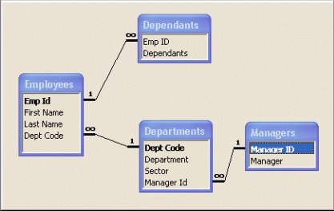
Relationships for Example 3
Normalization
Notes:
In an embedded system,
the processor would generally be a special purpose chip tailored for a specific application (e.g. cell phone processor, digital camera processor etc.)
BUS technology can be popular ones like PCI, PCIE, ISA etc.
There can be multiple levels of cache like L1, L2, L3 etc. for speeding up the instruction and data retrieval process
The size of the primary and secondary memories would vary based on the requirements of the system (e.g. a cell phone DRAM may be much lesser than that of a PC)
A variety of input and output devices based on the device like keypad, touchpad, LCD etc.
Communication Interfaces like Ethernet, Serial, Parallel etc. for the device to communicate with the external world
Special Purpose DSPs (Digital Signal Processors) for doing specific compute intensive mathematical operations (e.g. Analog to Digital Conversions).

Slide 97
Introduction to RDBMS and SQL
The content in this presentation is aimed at teaching learners to:
Define the term “RDBMS”
List the applications of RDBMS
Appreciate the advantages of DBMS
Connect to Oracle
Perform basic operations on database
Explain different parts of SQL and their purpose

Slide 98

Introduction to RDBMS and SQL
What is a Database?
Database is a collection of data elements. A relational database is collection of related data elements stored in the form of tables (i.e. rows and columns).
DEPT NAME | DEPT CODE
Accounting | 122
Research | 124
Sales | 123
Operations | 167
Research | 122
Sales | 122
Operations | 122
LOC NAME | LOC CODE
Chicago | L10
Atlanta | L20
New York | L30
Paris | L40
India | L50
Australia | L60
Africa | L70

Slide 99
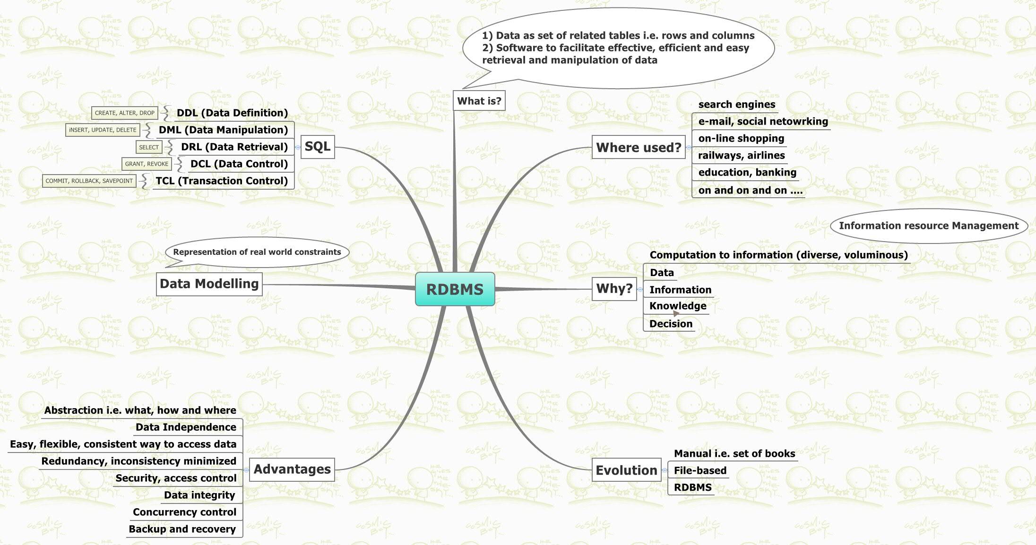
Introduction to RDBMS and SQL
What is RDBMS?
RDBMS (Relational Database Management System) is a software system used for controlling: creation, maintenance, and use of a Relational Database.

Slide 100
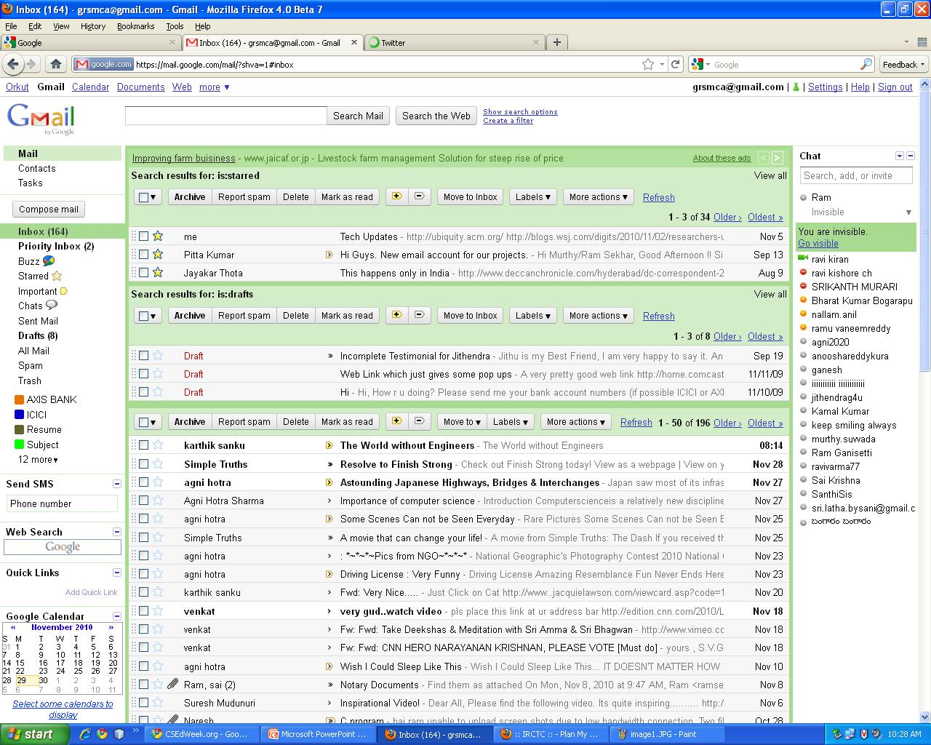
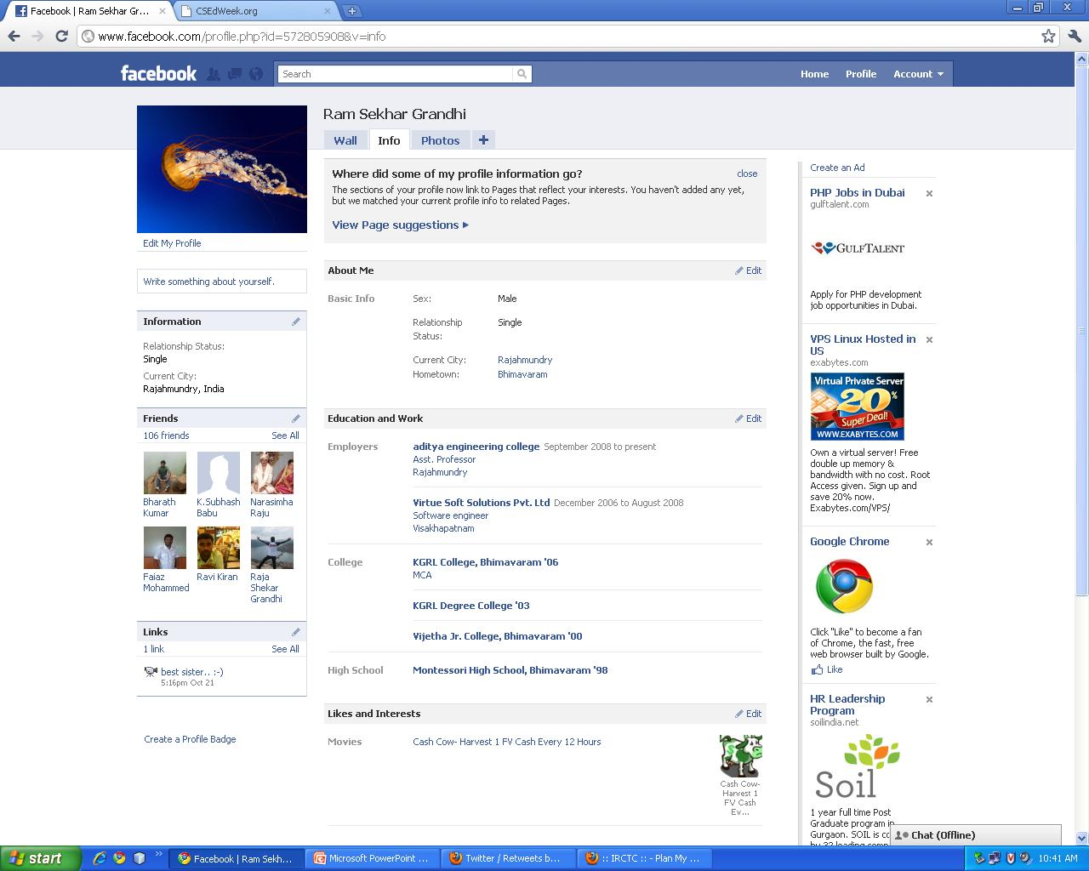

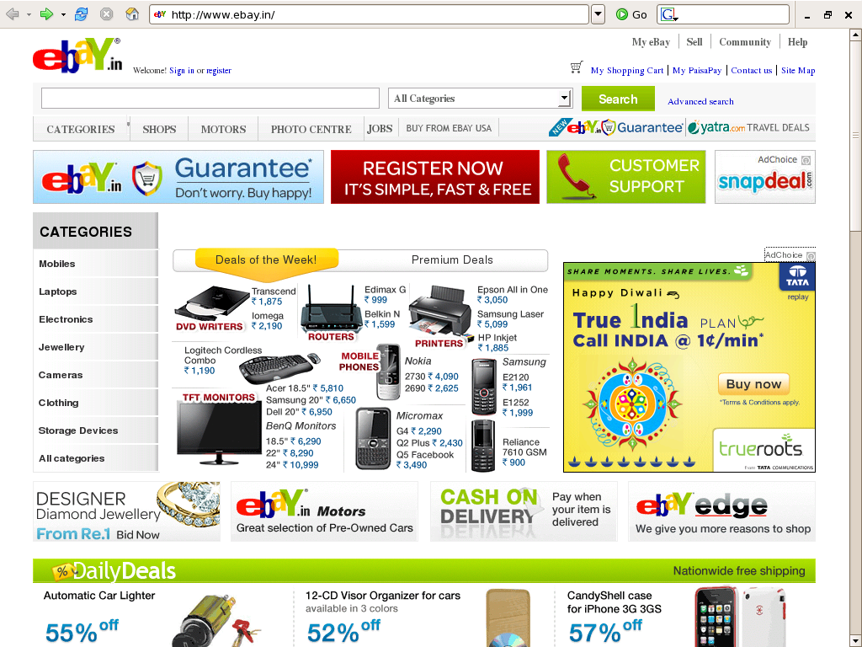
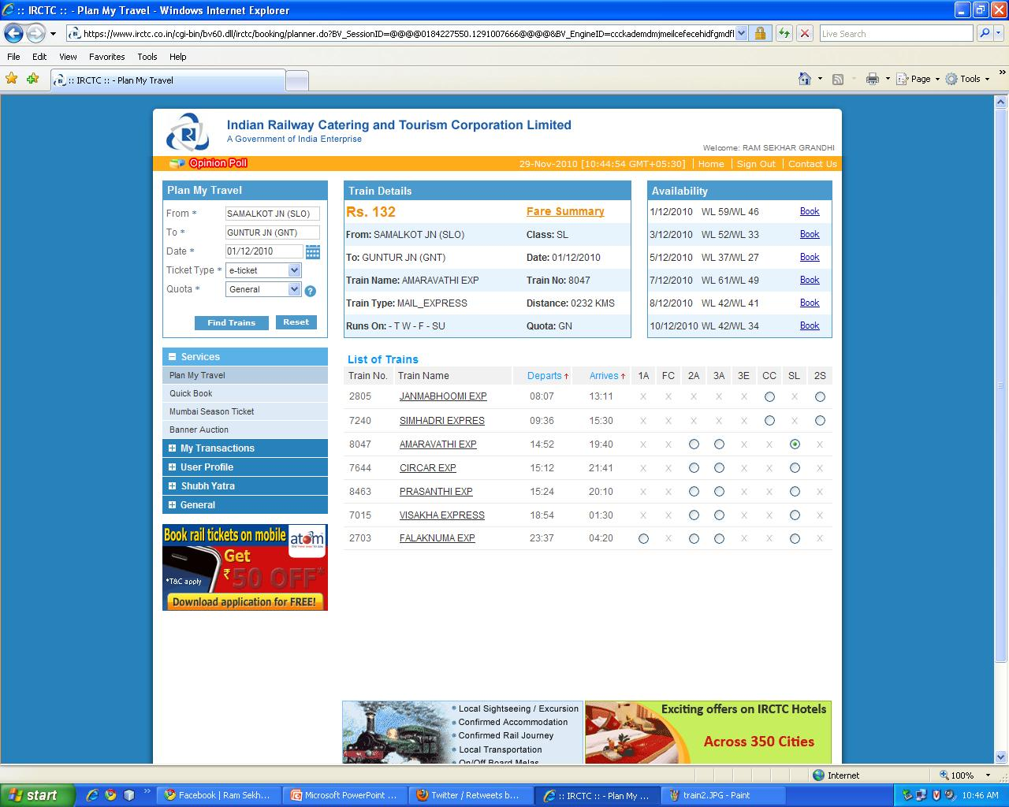
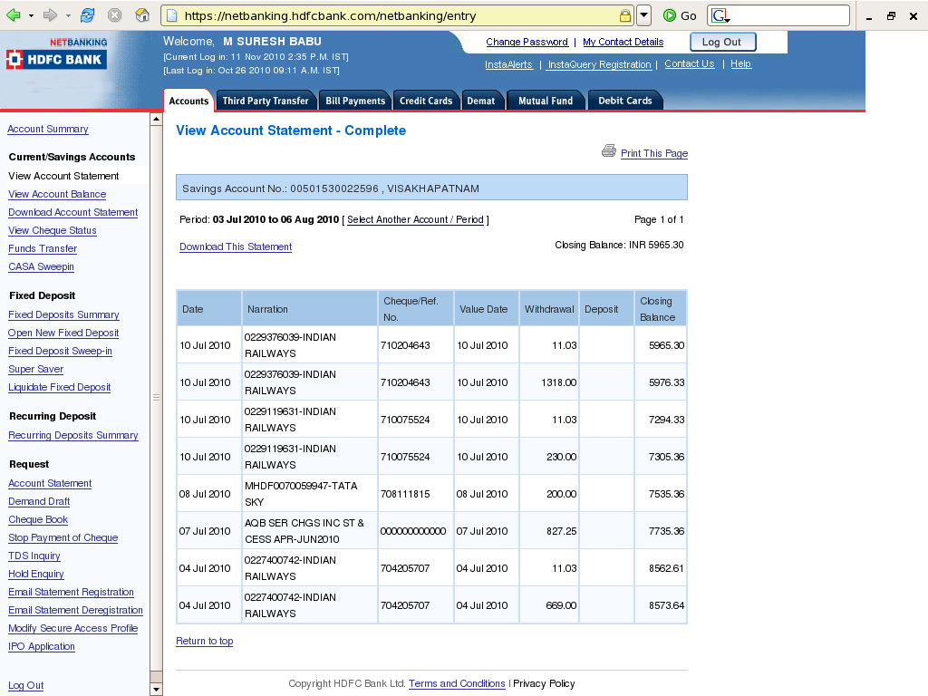

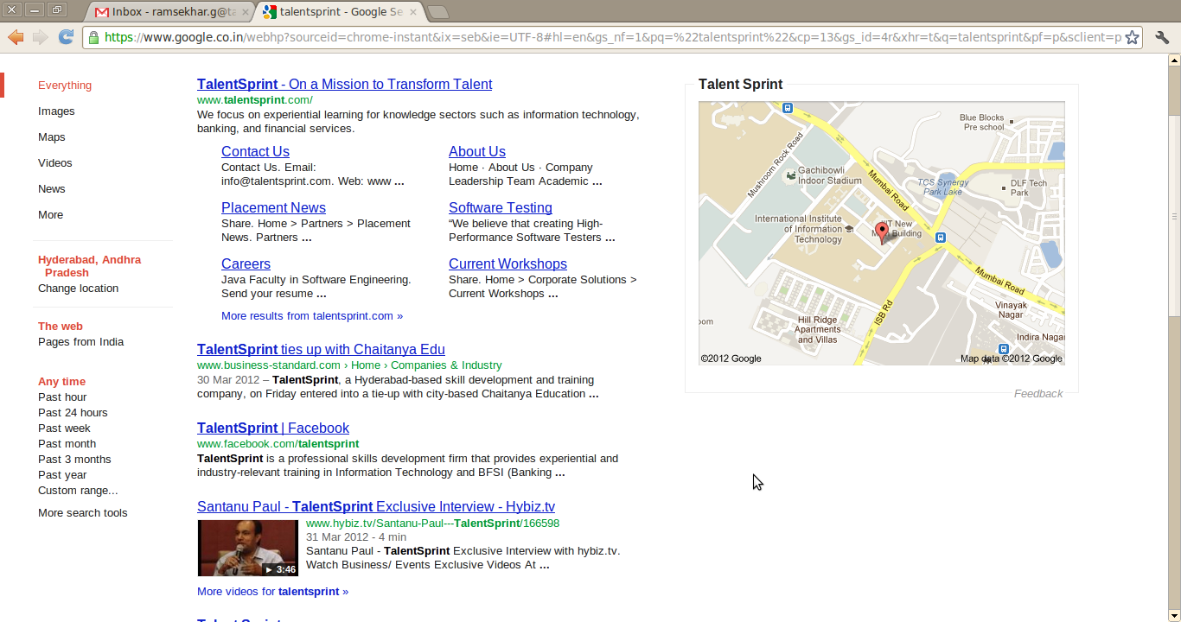
Introduction to RDBMS and SQL
Uses of RDBMS
Name any data-driven system and RDBMS is there…
Social Networking Application
Online Purchase Application
Passenger Reservation Application
Search Engine Applications
Banking Application
E-Mail Application
Retail Market Application
Micro-Blogging Application

Slide 101
Introduction to RDBMS and SQL
Data – Information - Knowledge
Data
Refers to either qualitative or quantitative attributes of a variable or set of variables (entity), which by themselves do not carry any meaning.
Must be interpreted to generate information.
Data
Data
Data
David | 500 | 250
John | 500 | 325
Peter | 500 | 150

Slide 102
Introduction to RDBMS and SQL
Data – Information - Knowledge
Information
Is the processed data.
Data
Information
David | 500 | 250
John | 500 | 325
Peter | 500 | 150
School Progress Report
Name | Max Marks | Gained Marks | Percentage
David | 500 | 250 | 50%
John | 500 | 325 | 65%
Peter | 500 | 150 | 30%

Slide 103
Introduction to RDBMS and SQL
Data – Information - Knowledge
Knowledge
Is the information presented in a way to facilitate decision making.
Information
Knowledge
School Progress Report
Name | Max Marks | Gained Marks | Percentage
David | 500 | 250 | 50%
John | 500 | 325 | 65%
Peter | 500 | 150 | 30%
David Passed
John Passed
Peter Failed

Slide 104
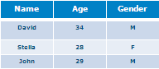



Introduction to RDBMS and SQL
Database Management
Data and Information are most important resources of any organization. They should be stored, maintained and protected from misuse. This is called Database Management.
Store
Maintain
Database Management
Protect

Slide 105
Introduction to RDBMS and SQL
Data Organization and Management
Manual Process
Previously, data management used to be a manual process involving lots of book keeping.
Performing any changes to data was very difficult.
Data availability was limited to only one person at a time.
Using Files
Electronic data processing, initially used Files for data management.
Need for a collection of records triggers file creation.
The major factor in the workload of Electronic Data Processing is to create and maintain files.
File management includes File Creation, Maintenance, Processing, Selection and Extraction of Records.

Slide 106
Introduction to RDBMS and SQL
Drawbacks of File System
Data redundancy and inconsistency - Multiple file formats, duplication of information in different files.
Difficulty in accessing data - Need to write a new program to carry out every new task.
Data isolation - Multiple files and different file formats leads to data isolation.
Security problems - Hard to provide user access to some/part of data.
Notes:
Example for Point 1: Phone no of customer when changed, it should be modified both in Savings account record and Checking accounts record (If he has both accounts). Same data stored in multiple places called Data Redundancy. When Redundant data is stored, it occupies higher storage. If any one of the redundant record is forgotten to modify, it leads to Data Inconsistency.
Example for Point 2: Find out who live within a particular postal code area, A new application program to be written otherwise it is difficult to access the details. Conventional File System does not allow to retrieve data in a convenient and efficient manner.
Example for Point 3: Writing new application programs to appropriate data is difficult, because the files have different file formats.
Example for Point 4: For example Balance in the account should know to the owner of the account, but not to others.

Slide 107

Introduction to RDBMS and SQL
Advantages of DBMS over File Systems
Minimizes redundancy and inconsistency.
Availability of efficient security and access control.
Data Integrity can be ensured using constraints.
Concurrent access to database.
Easy backup and recovery of database.

Slide 108
Introduction to RDBMS and SQL
History of SQL
SQL was developed in 1970 at IBM by Donald D. Chamberlin and Raymond F. Boyce.
Initially, it was known as SEQUEL (Structured English QUEry Language), later changed to SQL.
First commercial version of SQL was released in 1979.
SQL was adopted as a standard in 1986 (SQL-86) by ANSI and then in 1987 by ISO.
Note: ANSI means American National Standards Institute and ISO means International Organization for Standardization. Both organizations set the standards for software and other products internationally.

Slide 109
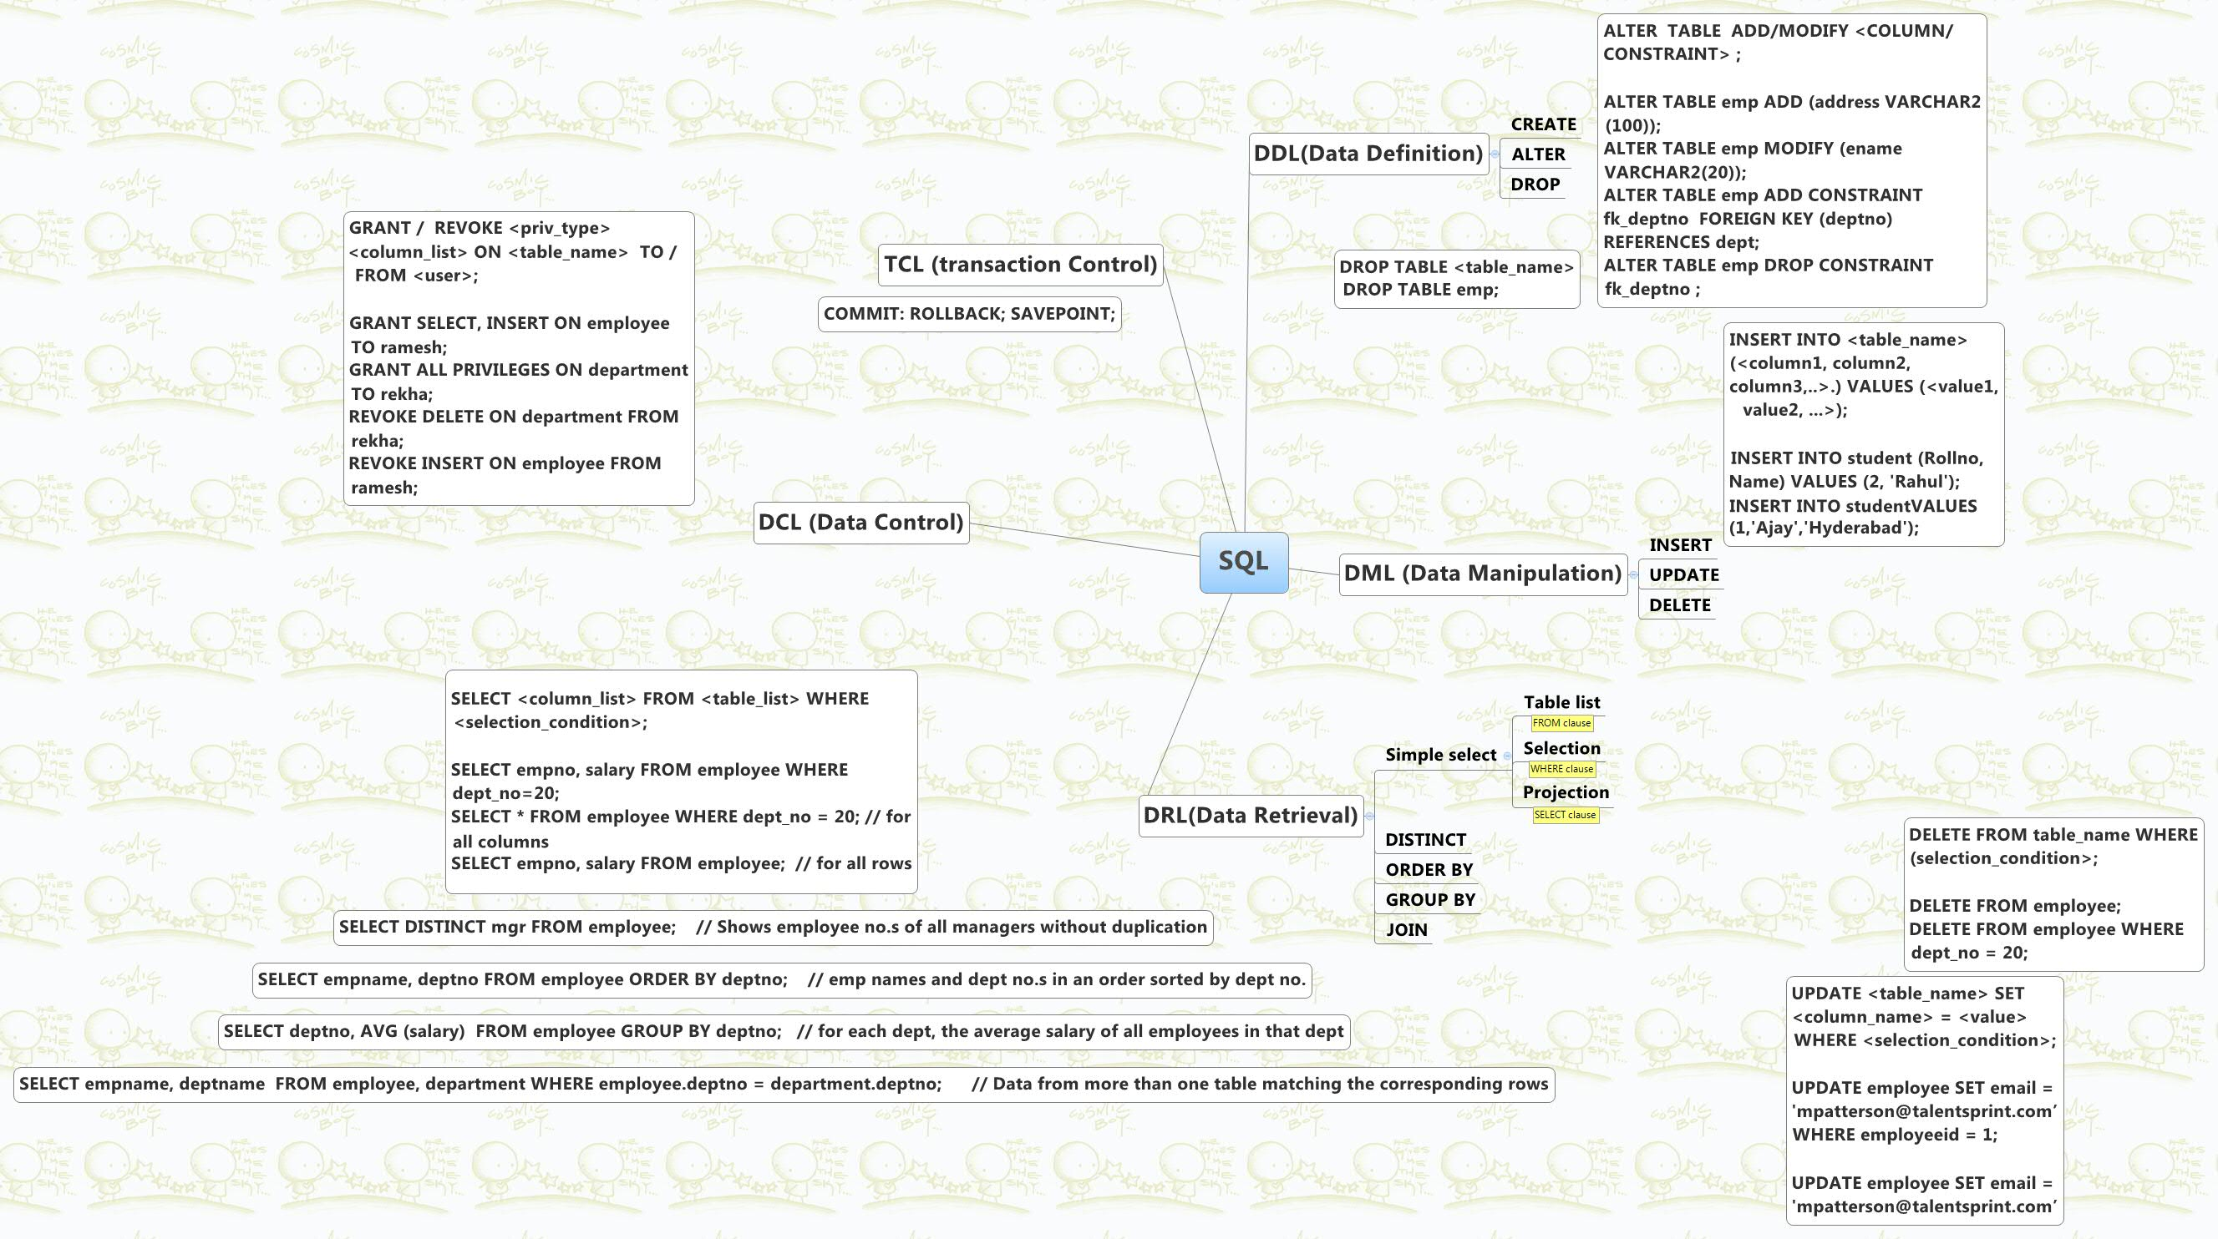
Introduction to RDBMS and SQL
SQL in a Nutshell

Slide 110

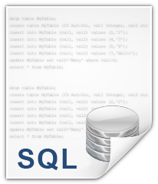

Introduction to RDBMS and SQL
Accessing and Modifying Databases
To access a database, a language called SQL(Structured Query Language) is used.
Name | Gained_Marks
David | 50
John | 65
Peter | 30
Database

Slide 111

Introduction to RDBMS and SQL
Languages in SQL
DRL / DQL
Data
Retrieval / Query Language
DML
TCL
Data Manipulation Language
Transaction Control Language
DDL
DCL
Data
Definition Language
Data
Control Language

Slide 112
Introduction to RDBMS and SQL
Languages in SQL
DDL
Data
Definition Language
DDL
CREATE
ALTER
DROP
To define structure of tables and other objects
To change the structure of a database object
To permanently remove a database object

Slide 113
Introduction to RDBMS and SQL
Languages in SQL
DML
Data Manipulation Language
INSERT
UPDATE
DELETE
To insert data into Tables
To modify existing data
To remove data from tables

Slide 114
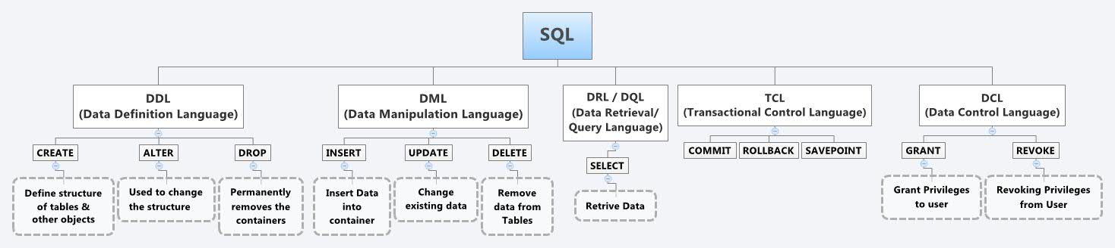
Introduction to RDBMS and SQL
Languages in SQL
DRL / DQL
Data
Retrieval / Query Language
SELECT
To retrieve data

Slide 115
Introduction to RDBMS and SQL
Languages in SQL
TCL
Transaction Control Language
COMMIT
ROLLBACK
SAVEPOINT

Slide 116
Introduction to RDBMS and SQL
Languages in SQL
DCL
Data
Control Language
GRANT
REVOKE
To grant privileges to users
To revoke privileges from users

Slide 117
Introduction to RDBMS and SQL
How to connect to a particular database?
Syntax:
mysql> CONNECT user;
Example:
mysql> CONNECT system;

Slide 118
Introduction to RDBMS and SQL
Display tables available in Database
mysql> select * from tab;

Slide 119
Built in functions
Number Functions : sum, min, max, count, round, rownum, floor, ceil, power, mod etc.
Date Functions : Current_date, add_months,last_day, next_day, sysdate,months_between etc
String/Character Functions : length, substr, trim, upper, lower, concat, initcap etc
Conversion Functions: to_char, to_date, to_number etc
Group the result and apply conditions : groupby, having
Notes:
Number functions: round
Truncate
Date :
sysdate
Extract
Character: lcase, ucase

Slide 120

SQL - Sub Queries
Introduction to Sub Queries
Display the list of employees working in ‘Finance’ Department.
EMPNO | ENAME | DEPTNO
1 | Venkat | 30
2 | Nirmala | 30
3 | John | 20
4 | Rahim | 40
5 | Harinder | 50
6 | Pooja | 50
SELECT eName FROM employee WHERE deptNo =
What is the Department Number for the ‘Finance’ Department!

Slide 121

SQL - Sub Queries
Introduction to Sub Queries
Let me look into Department table!
Ok! It is 20. Let me place this in the SELECT statement for selecting Employees
SELECT deptNo, dName FROM department WHERE dName = ‘Finance’;
DEPTNO | DNAME
20 | Finance
SELECT eName FROM employee WHERE deptNo =
20;

Slide 122
SQL - Sub Queries
Introduction to Sub Queries
I need not manually intervene to get the deptno for Finance. So, I write:
SELECT eName FROM employee WHERE deptNo = (SELECT deptNo FROM department WHERE dName = ‘Finance’);
You can also write the query like this. It is much easier. It is called Sub Query – i.e., Sending one query’s result as value for another query.

Slide 123
SQL - Sub Queries
Introduction to Sub Queries
Display the list of employees reporting to the president.
EMPNO | ENAME | JCODE | DEPTNO | MGRNO
1 | Venkat | 672 | 30
2 | Nirmala | 671 | 30 | 1
3 | John | 674 | 20 | 1
4 | Rahim | 675 | 40 | 3
5 | Harinder | 676 | 50 | 2
6 | Pooja | 677 | 50 | 4
JCODE | JNAME
667 | Clerk
668 | Staff
671 | Sr. Manager
672 | President
SELECT eName FROM employee WHERE mgrNo = (SELECT empNo FROM employee WHERE jCode =
Again the same question. What is the jCode for President?
SELECT eName FROM employee WHERE mgrNo = (SELECT empNo FROM employee WHERE jCode = (SELECT jCode FROM job WHERE jName = ‘President’));

Slide 124

SQL - Sub Queries
Exercise
Sub Queries – Exercise
Display list of employees working under either Pradeep or Srinivas.
Select ename from employee where mgrno = (select eid from employee
Where ename = ‘Pradeep’ or ‘Srinivas’);
Display list of employees who are in accounts department.
Select ename from employees where deptcode =(
Seelct deptcode from department where dname=‘account’
);

Slide 125
SQL - Sub Queries
Multiple Row Sub Queries
Display the details of employees working in Sales department.
EMPNO | ENAME | JCODE | DEPTNO | MGRNO
7 | Rajeev | 679 | 70
8 | Mohan | 680 | 70 | 1
9 | Sumana | 684 | 70 | 1
10 | Ragini | 685 | 80 | 3
11 | Ranjeet | 686 | 90 | 2
12 | Pooja | 687 | 90 | 4
DEPTNO | DNAME | DSUBTYPE
70 | Sales | Local
80 | Sales | International
90 | Sales | Internal
SELECT * FROM employee WHERE deptNo = (SELECT deptNo FROM department WHERE dName=‘Sales’);
Will the above query give us the desired output?
No. The sub query retrieves more than one value. deptno refers to one value i.e. value of deptno column in the current row. We cannot compare one value with multiple values for equality.

Slide 126
SQL - Sub Queries
Multiple Row Sub Queries
The sub-queries that return multiple rows are called multiple row sub-queries.
To handle these type of queries, we need to use the following operators: ALL, ANY, SOME, IN, EXISTS.
Among these operators, ALL, ANY and SOME are used along with the relational operators.
Based on this, the query to retrieve employees in sales department can be written as:
SELECT * FROM employee WHERE deptNo = ANY(SELECT deptNo FROM department WHERE dname=‘Sales’);

Slide 127
SQL - Sub Queries
Multiple Row Sub Queries
Display the names of employees who are earning more than Pradeep or Srinivas.
SELECT eName FROM employee WHERE salary > SOME (SELECT salary FROM employee WHERE eName = ‘Pradeep’ OR eName = ‘ Srinivas’);
Is there any commonality between ANY and SOME?
SOME is synonym for ANY.

Slide 128
SQL - Sub Queries
Multiple Row Sub Queries
Display the list of employees taking highest salary in the deptNo 40.
SELECT eName FROM employee WHERE deptno = 40 AND salary >= ALL(SELECT salary FROM employee WHERE deptNo=40);
ALL evaluates to TRUE if all of the values returned by the inner query satisfies the condition in the outer query.

Slide 129
SQL - Sub Queries
Multiple Row Sub Queries
Display the list of employees who are managers of other employees.
SELECT eName FROM employee WHERE empNo IN(SELECT mgrNo FROM employee);
IN evaluates to TRUE if any of the values returned by the sub query is equal to the value in the outer query. IN is equivalent to =ANY;

Slide 130
SQL - Sub Queries
Correlated Sub Queries
Display the list of employees whose join date is earliest in their respective departments.
EMPNO | ENAME | DEPTNO | HIREDATE
1 | Venkat | 40 | 2006-02-01
2 | Nirmala | 20 | 2007-04-02
3 | John | 40 | 2009-03-02
4 | Rahim | 40 | 2005-04-12
5 | Harinder | 30 | 2007-06-29
6 | Pooja | 40 | 2010-12-05
15 | Manoj | 30 | 2008-11-06
16 | Santosh | 20 | 2005-05-05
17 | Shalini | 20 | 2010-10-21
18 | Priya | 30 | 2011-01-05
These type of sub-queries where the inner query depends on outer query are called co-related sub-queries.
So, to check the department and respective date of joining of employee, the current row’s department no must be equated while retrieving the hire dates using the sub-query.
We want to check every employee if he is the one who joined first in his department (not all).

Slide 131
SQL - Sub Queries
Correlated Sub Queries
So, to display the list of employees whose join date is earliest in their respective departments, use following type of statement:
EMPNO | ENAME | DEPTNO | HIREDATE
1 | Venkat | 40 | 2006-02-01
2 | Nirmala | 20 | 2007-04-02
3 | John | 40 | 2009-03-02
4 | Rahim | 40 | 2005-04-12
5 | Harinder | 30 | 2007-06-29
6 | Pooja | 40 | 2010-12-05
15 | Manoj | 30 | 2008-11-06
16 | Santosh | 20 | 2005-05-05
17 | Shalini | 20 | 2010-10-21
18 | Priya | 30 | 2011-01-05
SELECT eName FROM employee e1 WHERE e1.hiredate <= ALL(SELECT hiredate FROM employee e2 WHERE e2.deptNo = e1.deptNo);

Slide 132
SQL - Sub Queries
Note:
If the same column (if any) present in both inner query and outer query (or a single table used in both main and sub-query), must be prefixed with table alias name to avoid ambiguity.
An alias name defined for a table can only be used in the same query.

Slide 133
SQL - Sub Queries
Correlated Sub Queries
Find the names of departments that has at least one employee?
SELECT dName FROM department d WHERE EXISTS(SELECT * FROM employee e WHERE d.deptNo = e.deptNo);
The EXISTS keyword returns TRUE if the sub-query retrieves at least one row. Otherwise it returns FALSE.
When used with NOT, it returns TRUE, if the sub-query does not return any rows.

Slide 134
SQL - Sub Queries
Exercise
Sub Queries – Exercise
Write a query to display the names and salaries of employees in Research Department.
Find the employee’s who are getting maximum salary in their respective job

Slide 135
Introduction to JOINS
Display the list of employees and their department numbers.
SELECT eName, deptNo FROM employee
The result is:
ENAME | DEPTNO
Venkat | 30
Nirmala | 30
John | 20
Rahim | 40
Harinder | 50
Pooja | 50
What, if we need Department Names too!

Slide 136
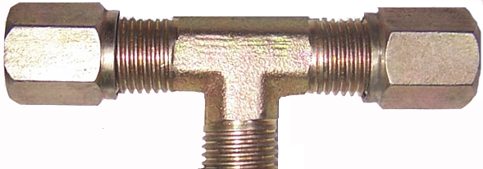
Introduction to JOINS
To display the list of employees and their department names, data has to come from two tables – Employee and Department.
In such case we use the concept of JOINS in SQL.
EMPNO | ENAME | DEPTNO
1 | Venkat | 30
2 | Nirmala | 30
3 | John | 20
4 | Rahim | 40
DEPTNO | DNAME | LCODE
20 | Finance | 142
30 | Testing | 123
40 | Dev | 123
50 | HR | 130
ENAME | DNAME
Venkat | Testing
Nirmala | Testing
John | Fianace
Rahim | Dev
The Syntax of the JOIN Statement:
SELECT <list_of_columns> FROM <list_of_tables> WHERE <join_condition>

Slide 137
Introduction to JOINS
The JOIN statement to display the list of employees and their department names can be:
SELECT eName, dName FROM employee, department WHERE employee.deptNo = department.deptNo;
The result is:
ENAME | DNAME
Venkat | Testing
Nirmala | Testing
John | Finance
Rahim | Dev

Slide 138
How JOIN Works Conceptually
SELECT eName, dName FROM employee, department WHERE employee.deptNo = department.deptNo;
The query, first takes the department number of each employee, compares it with the deptno of department table. When there is a match, displays ename from employee table and the corresponding dname from the Department table:
DNAME
Testing
Testing
Fianace
Dev
ENAME
Venkat
Nirmala
John
Rahim
DEPTNO | DNAME | LCODE
20 | Finance | 142
30 | Testing | 123
40 | Dev | 123
50 | HR | 130
EMPNO | ENAME | DEPTNO
1 | Venkat | 30
2 | Nirmala | 30
3 | John | 20
4 | Rahim | 40

Slide 139
Note:
The names of the columns (if any) present in more than one table, must be prefixed with table name or table alias name to avoid ambiguity.
Table aliases are the short names given to the tables for easy usage.
An alias name defined for a table can only be used in the same query.

Slide 140
Query using Alias
SELECT eName, dName FROM employee e, department d WHERE e.deptNo = d.deptNo;
Note:
When the join condition is omitted, the result of the query will be Cartesian product of the tables. That means every row in first table will be joined with every row in second table.

Slide 141
Query using Alias
We want the names of the employees along with their department names and the location names of the department. For this:
The query is:
SELECT eName, dName, lName FROM employee e, department d, location l WHERE e.deptNo=d.deptNo AND d.lCode=l.lCode;
The result is:
ENAME | DNAME | LNAME
Venkat | Testing | Atlanta
Nirmala | Testing | Atlanta
John | Fianace | Delhi
Rahim | Dev | Atlanta
Data can be retrieved from any number of tables at a time using joins.

Slide 142
SELF JOIN
Display the names of all the employees and their manager names.
EMPNO | ENAME | JCODE | DEPTNO | MGRNO | MGRNAME
7 | Rajeev | 679 | 70
8 | Mohan | 680 | 70 | 7 | Rajeev
9 | Sumana | 684 | 70 | 7 | Rajeev
10 | Ragini | 685 | 80 | 9 | Sumana
11 | Ranjeet | 686 | 90 | 8 | Mohan
12 | Pooja | 687 | 90 | 11 | Ranjeet
Here both the employee name and the manager names are in the same table (employee), but from different records. In such cases, we join the table with itself, which is known as SELF JOIN
The query is:
SELECT w.eName, m.eName FROM employee w, employee m WHERE w.mgrNo = m.empNo

Slide 143
Display the employee name and job name of all the employees.
Display department name and its location name for all departments.
Display the employee name and job name of all the employees in department no. 30.
Display employee name and department name for all analysts.
Exercise

Slide 144
Ways of JOINing
JOINING of tables can be done in the following ways:
Using WHERE clause
Using JOIN keyword

Slide 145
INNER JOIN
INNER JOIN identifies and combines only matching rows which are stored in two or more related tables.
JOIN condition is written with:
ON clause (used when joining column has a different name)

Slide 146
INNER JOIN with ON Clause
Syntax:
SELECT <column list> FROM <table1> INNER JOIN <table2>
ON <table1>.<column1>= <table2>.<column2> [INNER JOIN <table3> ON <table2.Column3>=<table3.Column4>…];
Example:
To display the list of employee names and their manager names:
The statement is written as:
SELECT w.eName, m.eName FROM employee w INNER JOIN employee m ON w.mgrNo = m.empNo;

Slide 147
OUTER JOIN
OUTER JOIN allows us to retrieve all values in a certain table regardless of whether these values are present in other tables.
The types of OUTER JOIN are:
LEFT OUTER JOIN
RIGHT OUTER JOIN

Slide 148
LEFT OUTER JOIN
This type of JOIN displays the matching records from both tables and all unmatched records of the left table.
Note:
Left table means which table name is listed on the left side of the JOIN keywords.
Syntax:
SELECT <column list> FROM <table1> LEFT OUTER JOIN <table2> ON <table1.column1>= <table2.column2>;

Slide 149
LEFT OUTER JOIN – Example
Display the department names and employees in each department. Also display names of departments even if it does not contain any employees. For this:
The statement is written as:
SELECT d.deptNo, d.dName, e.empNo, e.eName FROM department d LEFT OUTER JOIN employee e ON d.deptNo = e.deptNo;

Slide 150
RIGHT OUTER JOIN
This type of join will display matching records from both tables and all unmatched records in the right table.
Note:
Right table means which table name is listed on the right side of the JOIN keywords.
Syntax:
SELECT <column list> FROM <table1> RIGHT OUTER JOIN <table2> ON <table1.column1>= <table2.column2>;

Slide 151
RIGHT OUTER JOIN – Example
Display the list of employees and their department names. Also display employee name even if he doesn’t belong to any dept. For this:
The statement is written as:
SELECT d.deptNo, d.dName, e.empNo, e.eName FROM department d RIGHT OUTER JOIN employee e ON d.deptNo = e.deptNo;

Slide 152
CROSS JOIN
The CROSS JOIN operation retrieves data between two tables as a Cartesian product.
Cartesian product or CROSS JOIN is formed, when the joining condition is omitted or the specified condition is invalid or by explicitly specifying the CROSS JOIN clause.
Syntax:
SELECT <column list> FROM <table1> CROSS JOIN <table2>;
The sample query to CROSS JOIN department and employee tables:
SELECT * FROM department CROSS JOIN employee;

Slide 153
Exercise
Write a query to display all the department names & their location names.
Write a query to display the name, job name, department name and location of every employee.
Write a query to display the List of departments with at least one ANALYST along with their location name.

Slide 154
Joins in Oracle
Equi
Self
Inner
Outer
Cross
Anti
Semi

Slide 155
Anti Join
Anti-join is used to make the queries run faster. It is a very powerful SQL construct Oracle offers for faster queries.
Anti-join between two tables returns rows from the first table where no matches are found in the second table. It is opposite of a semi-join. An anti-join returns one copy of each row in the first table for which no match is found.
Anti-joins are written using the NOT EXISTS or NOT IN constructs.

Slide 156
SELECT department.deptno, department.dname
FROM department
WHERE NOT EXISTS
(
SELECT 1
FROM employee e
WHERE e.deptno = department.deptno)
ORDER BY department.deptno;

Slide 157
Anti
The following example selects a list of employees who are not in a particular set of departments:
SELECT * FROM employees WHERE department_id NOT IN (SELECT department_id FROM departments WHERE location_id = 1700) ORDER BY last_name;

Slide 158
Semi Join
Semi-join is introduced in Oracle 8.0. It provides an efficient method of performing a WHERE EXISTS sub-query.
A semi-join returns one copy of each row in first table for which at least one match is found.
Semi-joins are written using the EXISTS construct.

Slide 159
SELECT department.deptno, department.dname
FROM department
WHERE EXISTS
(
SELECT 1
FROM employee
WHERE employee.deptno = department.deptno
)
ORDER BY department.deptno;

Slide 160
Semi
only one row needs to be returned from the departments table, even though many rows in the employees table might match the subquery. If no index has been defined on the salary column in employees, then a semijoin can be used to improve query performance.
SELECT * FROM departments WHERE EXISTS (SELECT * FROM employees WHERE departments.department_id = employees.department_id AND employees.salary > 2500) ORDER BY department_name;
Notes:
SELECT D.deptno, D.dname FROM dept D WHERE EXISTS ( SELECT 1 FROM emp E WHERE E.deptno = D.deptno ) ORDER BY D.deptno; The above query will list the departments that have at least one employee. Whether a department has one employee or 100, the department will appear only once in the query output. Moreover, Oracle will move on to the next department as soon as it finds the first employee in a department, instead of finding all of the employees in each department.

Slide 161
Anit Join and Semi Join
Semi Join returns one copy of each row in the first table for each at least one match is found.
Anti Join returns one copy of each row in the first table for which no match is found.

Slide 162


Slide 163
Set Operator
UNION
UNION ALL
INTERSECT
MINUS
Notes:
Number functions: round
Truncate
Date :
sysdate
Extract
Character: lcase, ucase

Slide 164
Union
select deptno from department
union
select deptno from employee;

Slide 165
Union ALL
select deptno from department union all select deptno from employee;

Slide 166
Intersect
select deptno from department intersect select deptno from employee;

Slide 167
Minus
select deptno from department minus select deptno from employee;

Slide 168
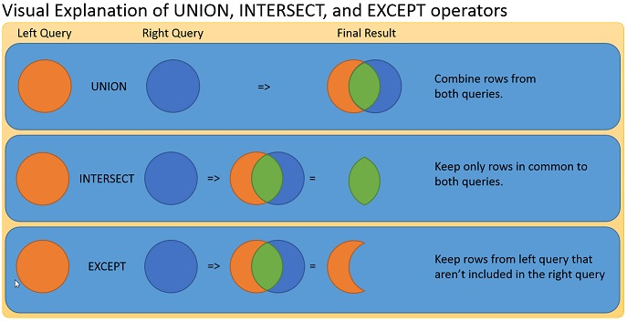
Notes:
JOIN:
A join is used for displaying columns with the same or different names from different tables. The output displayed will have all the columns shown individually. That is, the columns will be aligned next to each other.
UNION:
The UNION set operator is used for combining data from two tables which have columns with the same datatype. When a UNION is performed the data from both tables will be collected in a single column having the same datatype.

Slide 169
Sequence
CREATE SEQUENCE sequence_name
MINVALUE value
MAXVALUE value
START WITH value
INCREMENT BY value
CACHE value;
Insert into tablename values(sequence_name.nextval,’ll’);

Slide 170
Multiset Operator
Multiset operators combine the results of two nested tables into a single nested table.
CREATE TABLE customers_demo AS SELECT * FROM customers;
CREATE TABLE new_table AS (SELECT * FROM old_table WHERE 1=2);

Slide 171
IN , Not IN
SELECT * FROM orders WHERE order_id IN (10000, 10001, 10003, 10005);
SELECT * FROM customers WHERE customer_name NOT IN ( 'IBM', 'Hewlett Packard', 'Microsoft');

Slide 172
IS NULL
SELECT * FROM suppliers WHERE supplier_name IS NULL;
INSERT INTO suppliers (supplier_id, supplier_name) SELECT account_no, name FROM customers WHERE city IS NULL;
UPDATE suppliers SET name = 'Apple' WHERE name IS NULL;

Slide 173
IS NOT NULL
SELECT * FROM customers WHERE customer_name IS NOT NULL;

Slide 174
View
An Oracle VIEW, in essence, is a virtual table that does not physically exist. Rather, it is created by a query joining one or more tables.

Slide 175
View
CREATE VIEW view_name AS SELECT columns FROM tables [WHERE conditions];
Example:
CREATE VIEW sup_orders AS SELECT suppliers.supplier_id, orders.quantity, orders.price FROM suppliers INNER JOIN orders ON suppliers.supplier_id = orders.supplier_id WHERE suppliers.supplier_name = 'Microsoft';

Slide 176
Update View
CREATE OR REPLACE VIEW view_name AS SELECT columns FROM table WHERE conditions;

Slide 177
Drop View
DROP VIEW view_name;

Slide 178
REGEXP_LIKE condition
SELECT last_name FROM contacts WHERE REGEXP_LIKE (last_name, 'Anders(o|e|a)n');

Slide 179
REGEXP_LIKE condition
Match at end
SELECT last_name FROM contacts WHERE REGEXP_LIKE (last_name, '(*)n$');
Macth at beginning
SELECT last_name FROM contacts WHERE REGEXP_LIKE (last_name, '^A(*)');

Slide 180

Introduction to RDBMS and SQL

